Slide 1

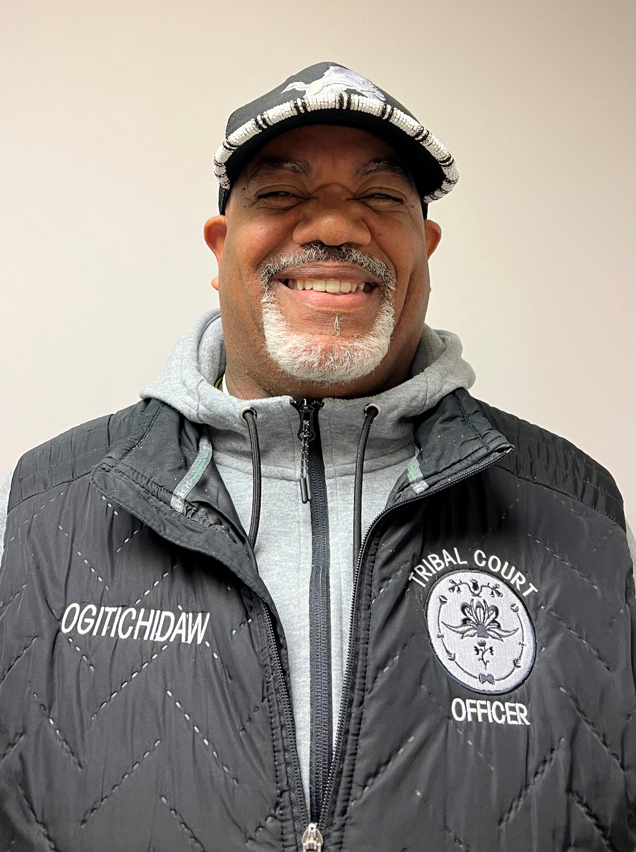
Honoring our Veterans
Kevin
Ricketts
AIR FORCE

Slide 2
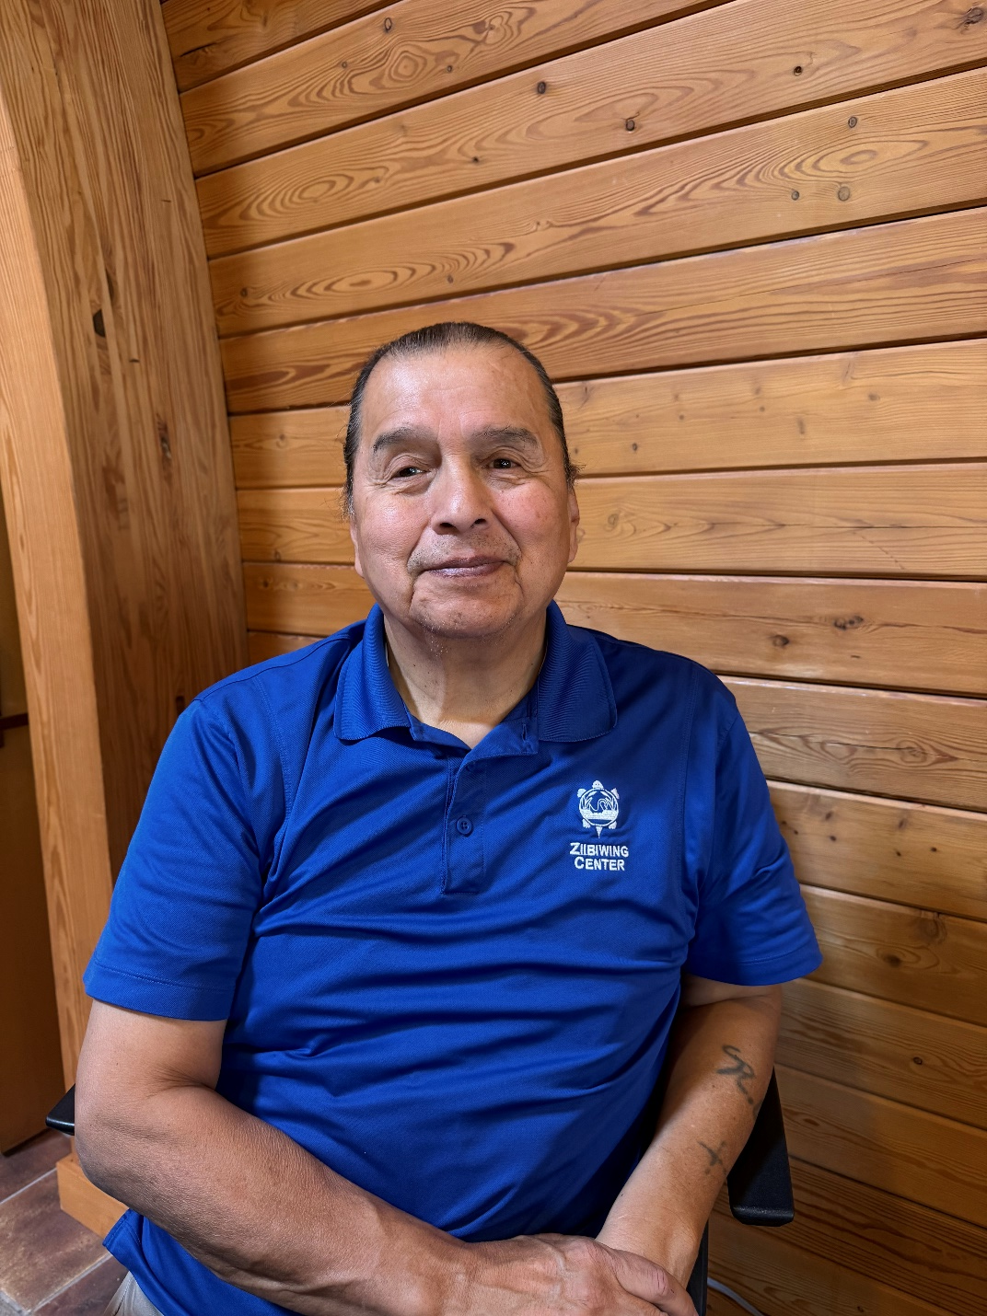
Honoring our Veterans
Ray Cadotte
ARMY

Slide 3
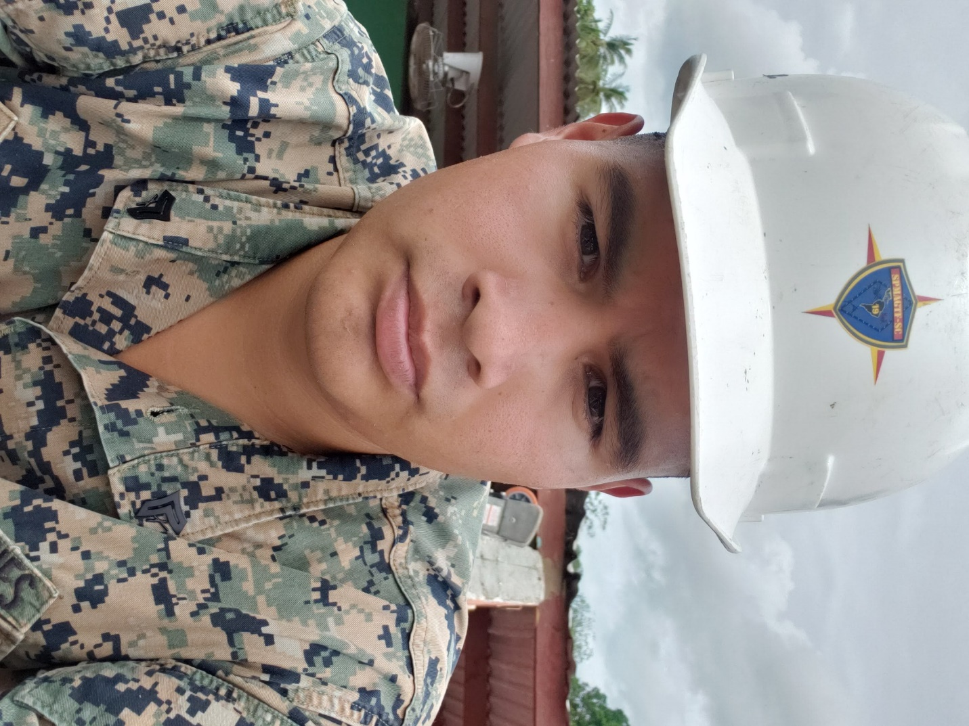
Honoring our Veterans
David Merrill Jr
MARINE CORPS

Slide 4
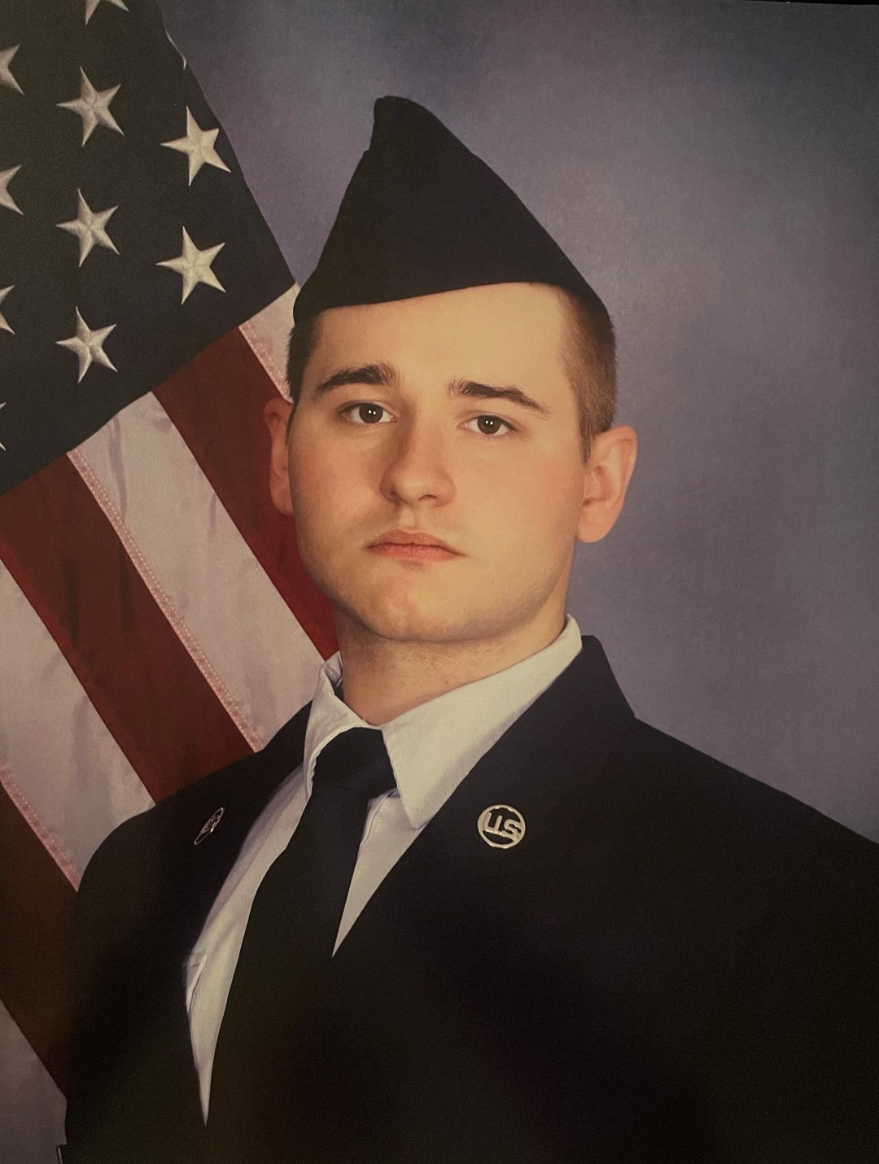
Honoring our Veterans
Nolan Buckey
AIR FORCE

Slide 5
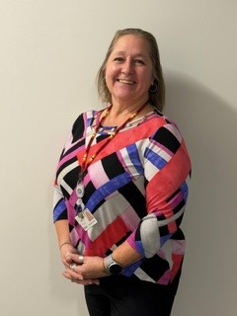
Honoring our Veterans
Misty Wolfgang
ARMY

Slide 6
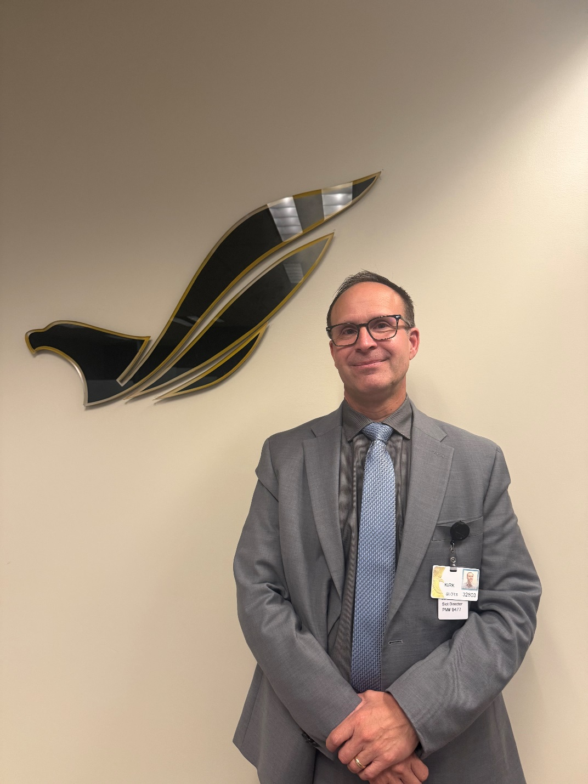
Honoring our Veterans
Kirk Walraven
MARINES

Slide 7
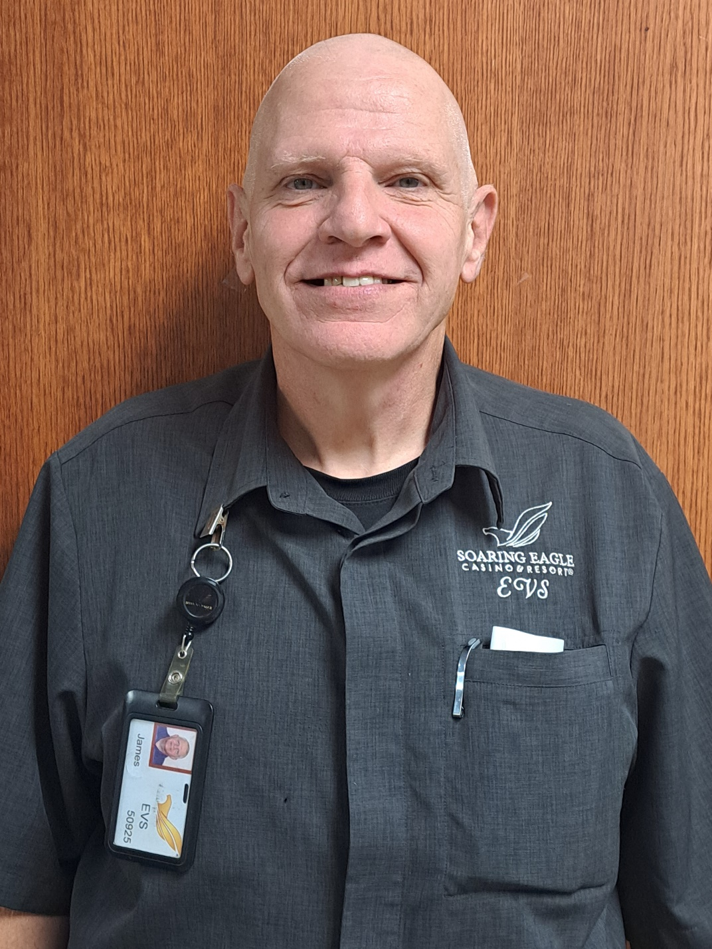
Honoring our Veterans
James Goff
ARMY

Slide 8
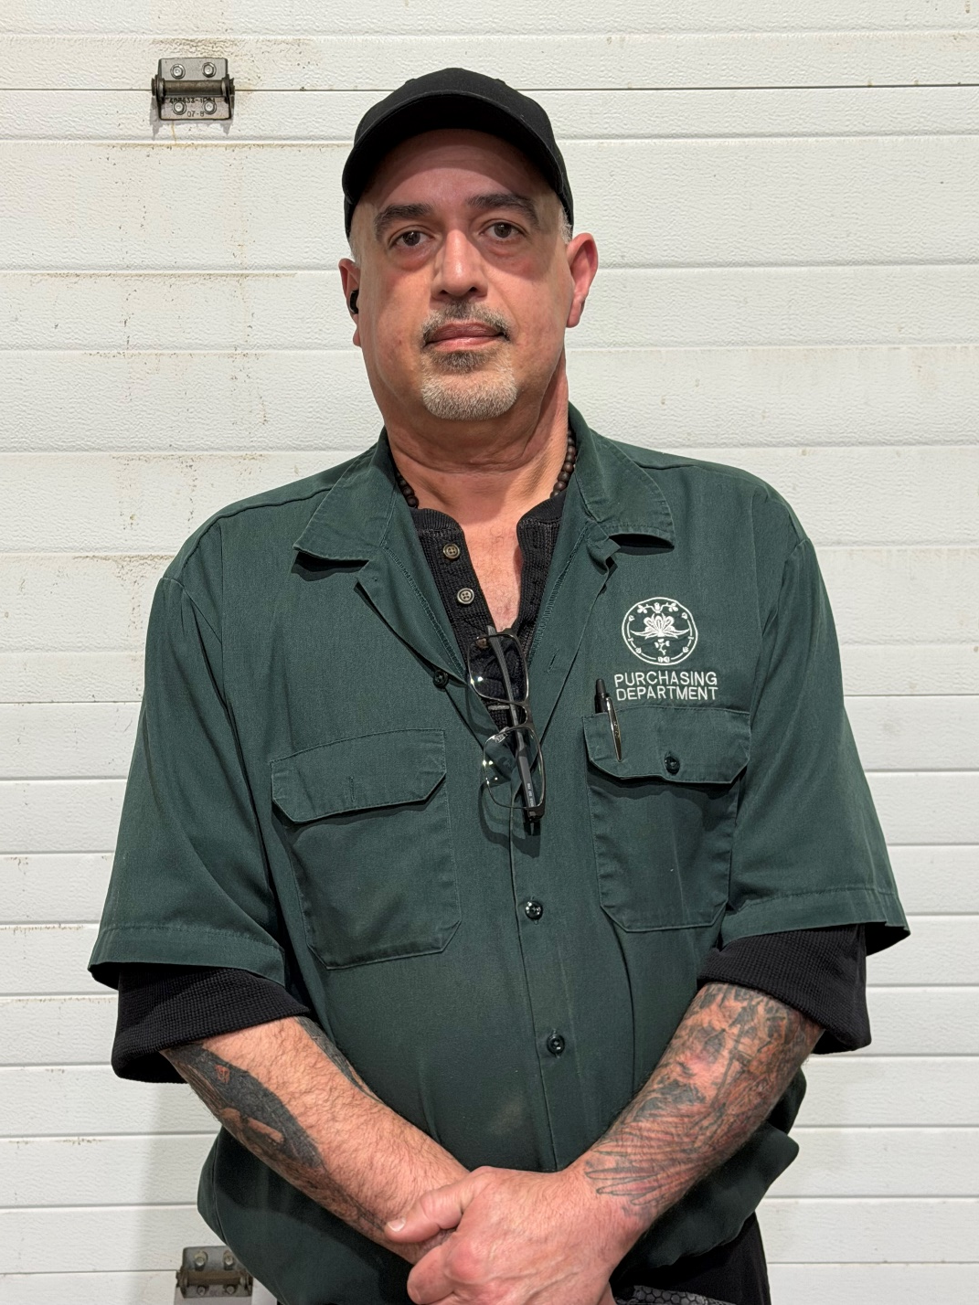
Honoring our Veterans
Albert Ortiz
AIR FORCE

Slide 9
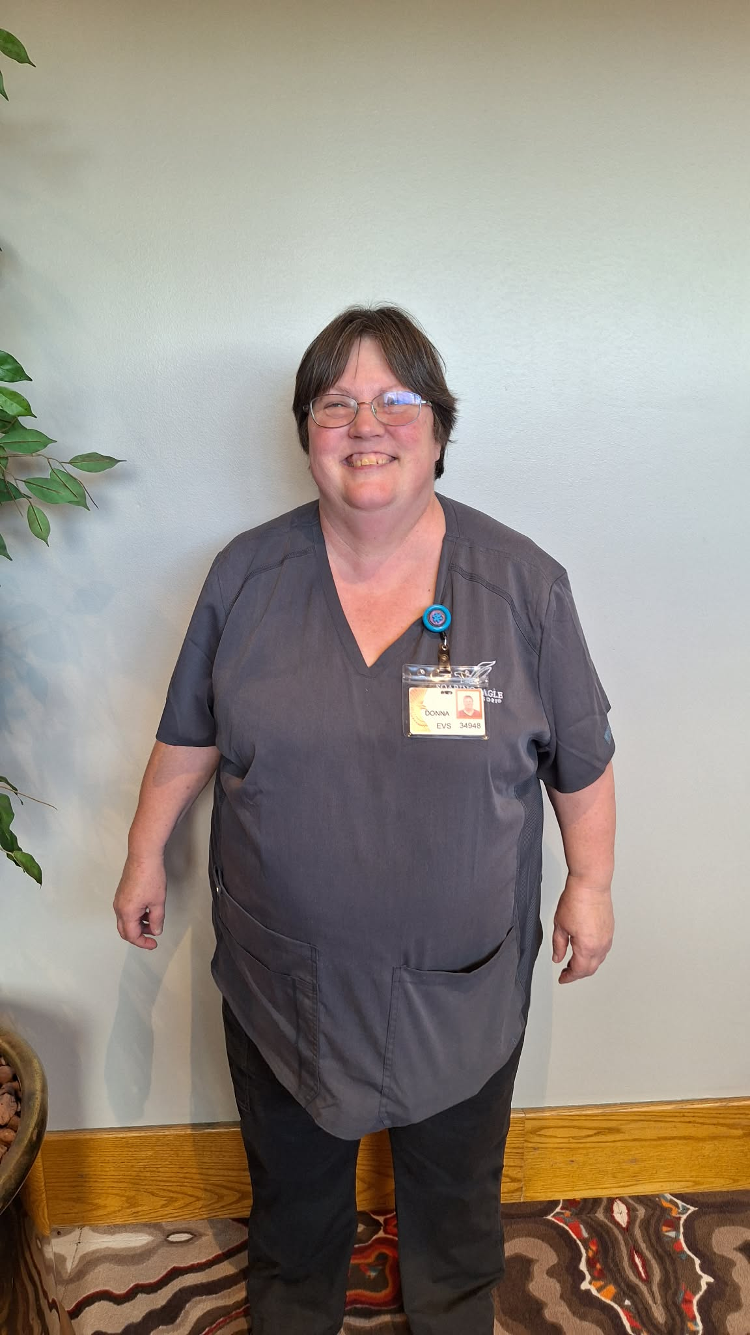
Honoring our Veterans
Donna Methner
ARMY

Slide 10
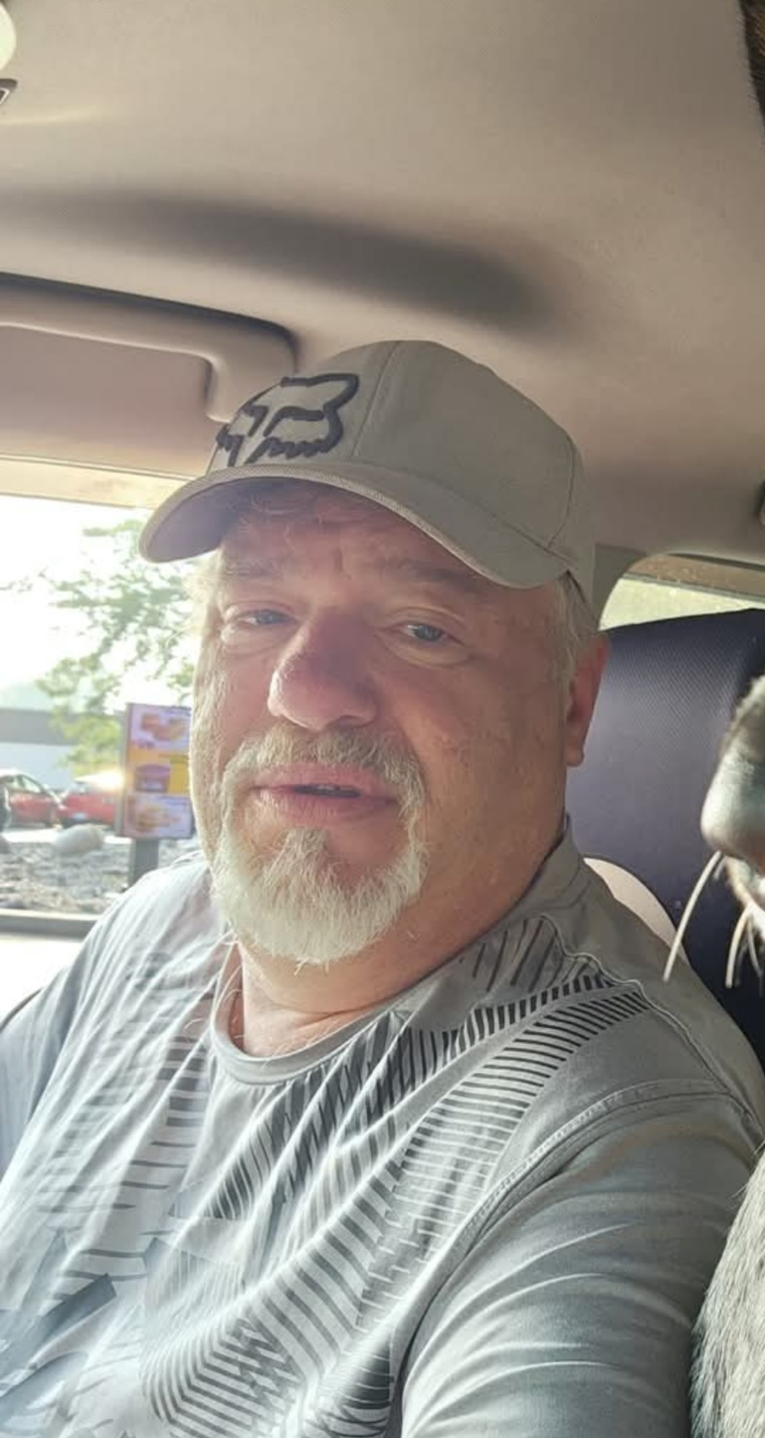
Honoring our Veterans
Jerome Steward
NAVY

Slide 11
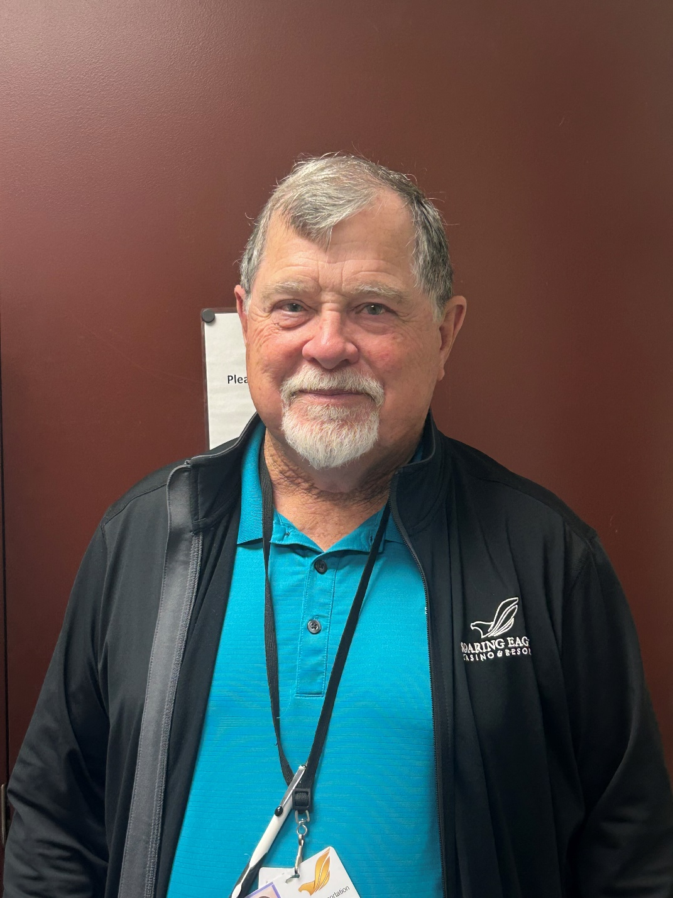
Honoring our Veterans
Willis Whetstone
ARMY

Slide 12
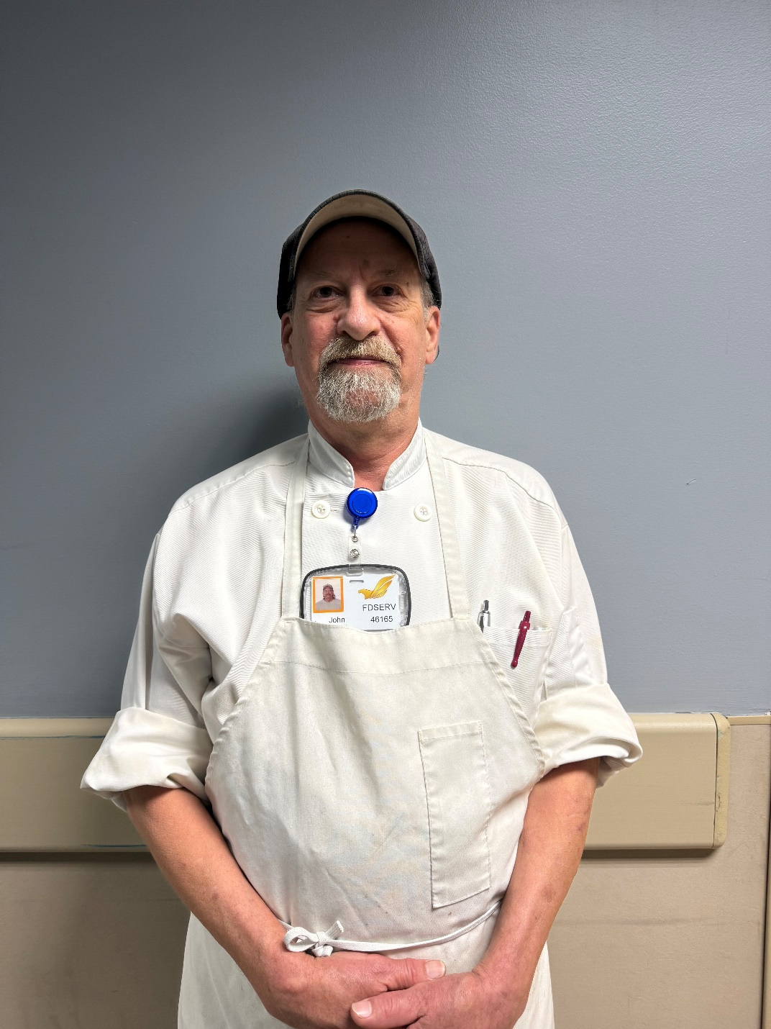
Honoring our Veterans
John Raby
AIR FORCE

Slide 13
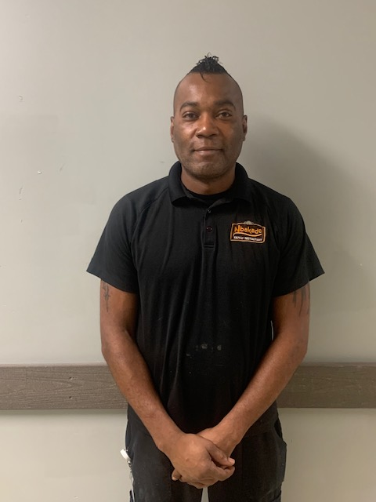
Honoring our Veterans
Toriano Lane
ARMY NATIONAL GUARD

Slide 14
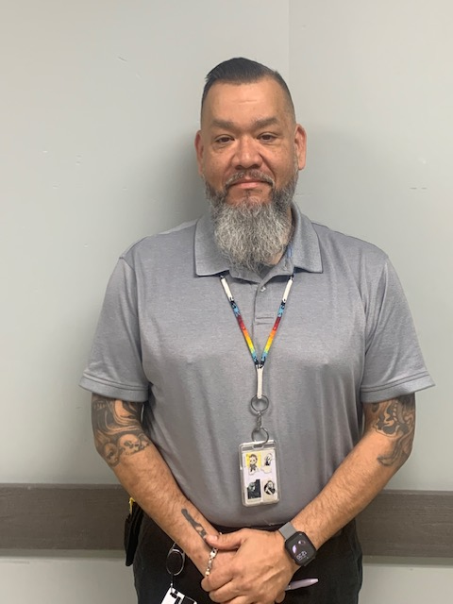
Honoring our Veterans
Ron Villanova
NAVY

Slide 15
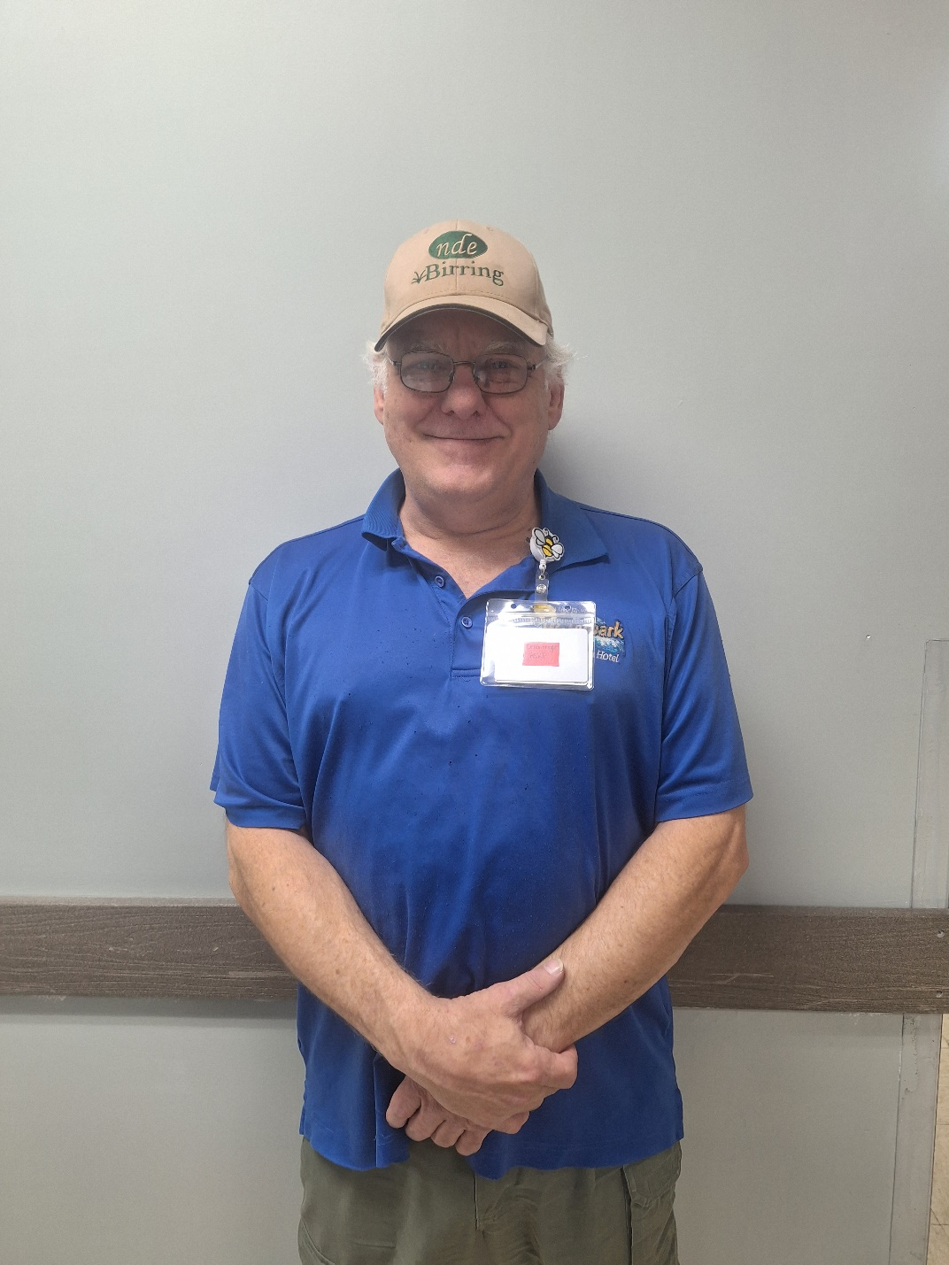
Honoring our Veterans
Dan Clevenger
ARMY

Slide 16
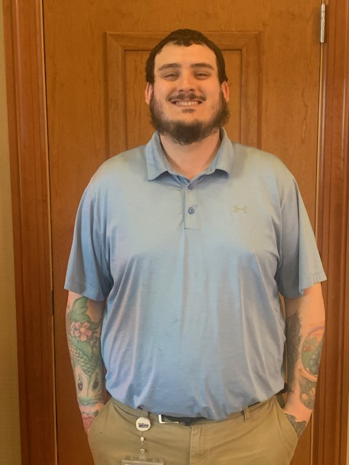
Honoring our Veterans
Bryce Holton
ARMY RESERVE

Slide 17
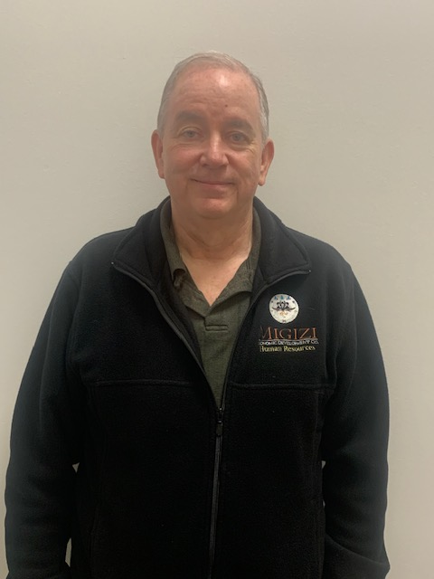
Honoring our Veterans
Kevin Humphreys
ARMY

Slide 18

Honoring our Veterans
Aaron Rop
NAVY

Slide 19
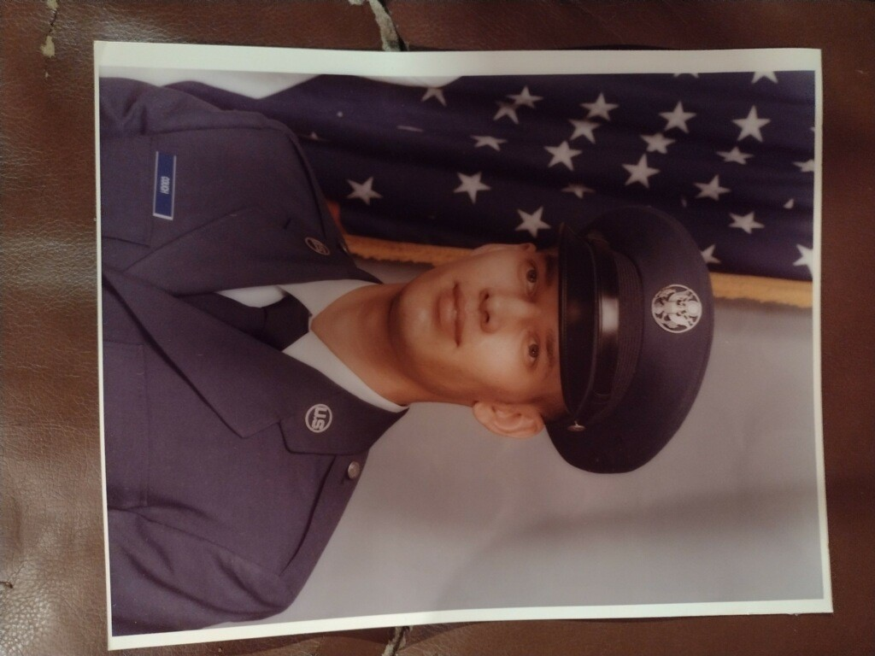
Honoring our Veterans
Chris Couch
AIR FORCE

Slide 20
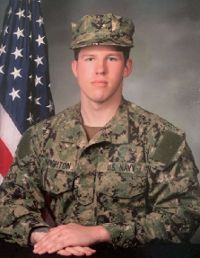
Honoring our Veterans
Alexander Houghton
NAVY

Slide 21
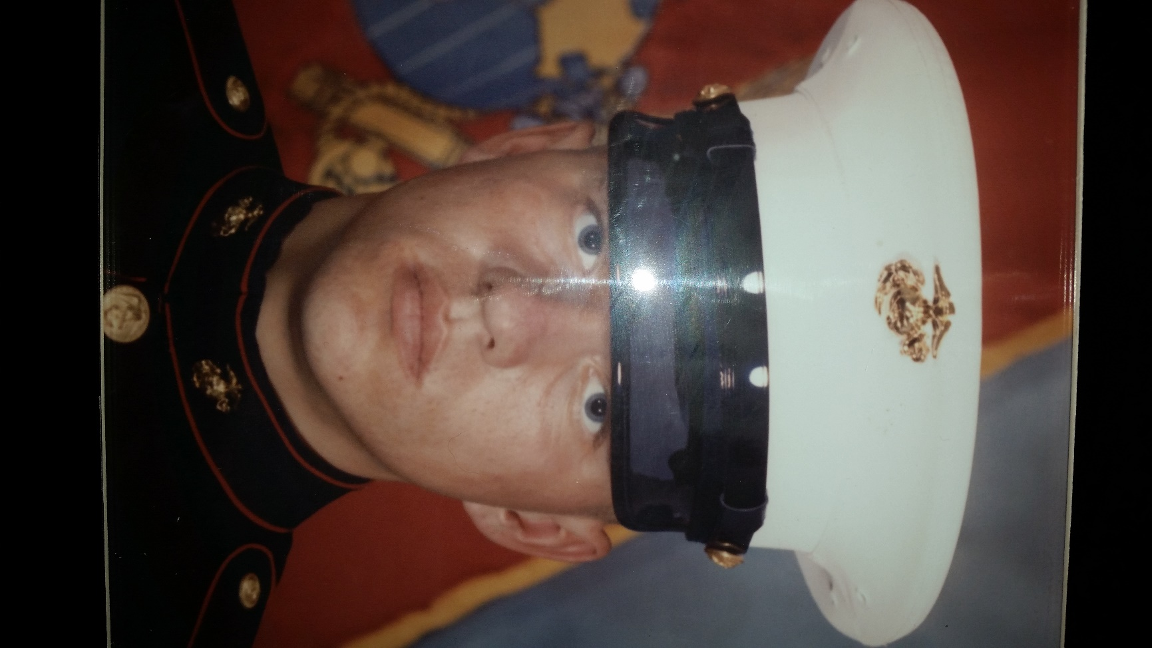
Honoring our Veterans
Chad Ervin
MARINES

Slide 22
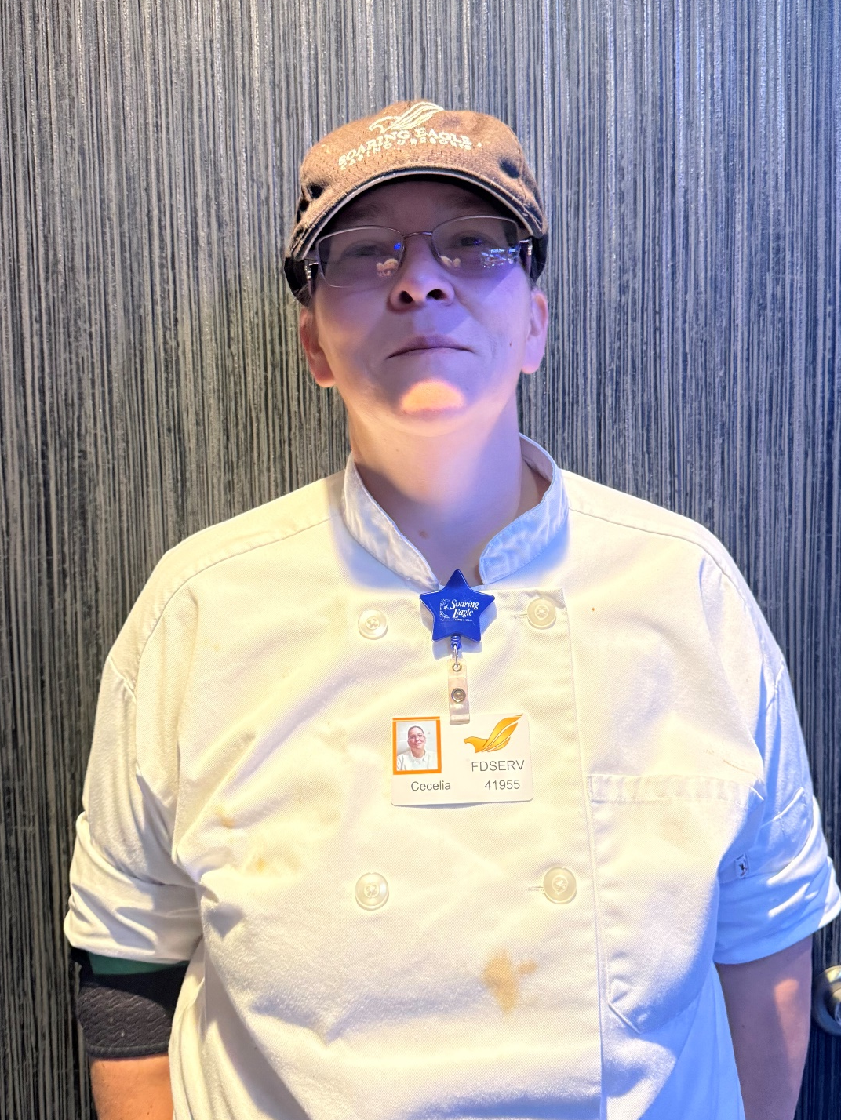
Honoring our Veterans
Cecelia Kemper
NAVY

Slide 23
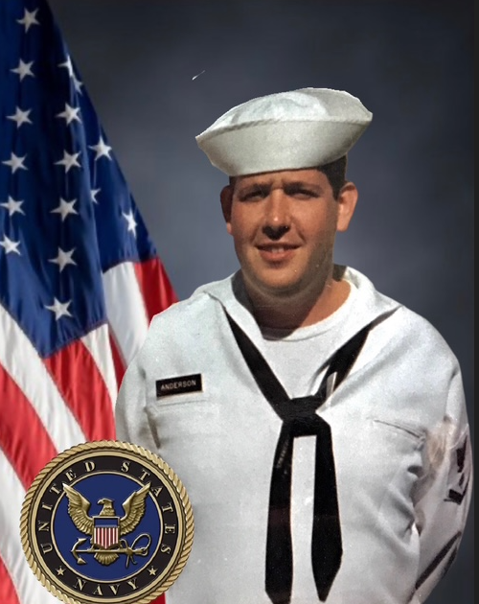
Honoring our Veterans
Jeffery Anderson
NAVY

Slide 24
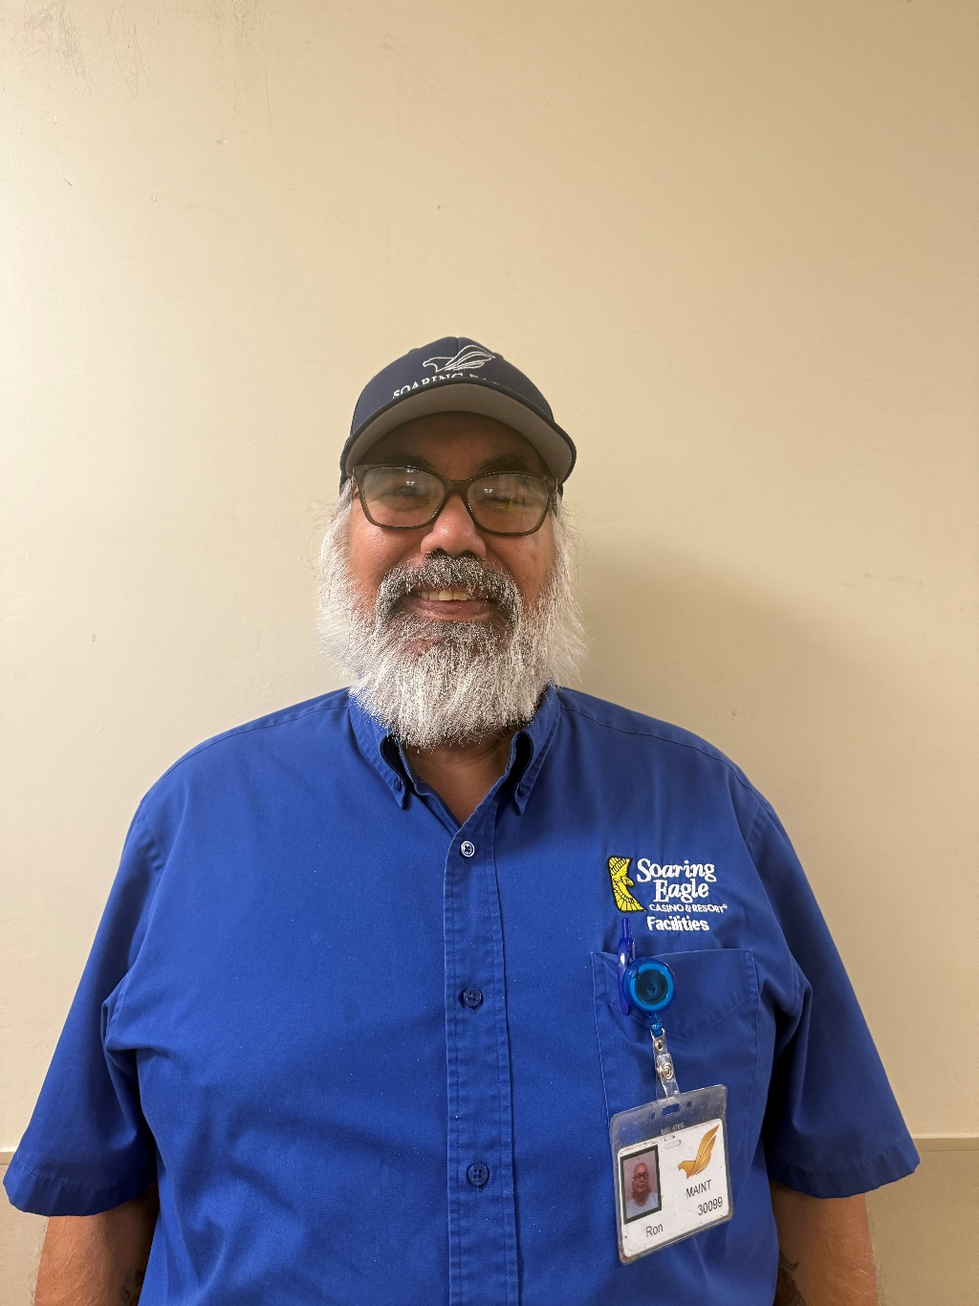
Honoring our Veterans
Ron Johansen
ARMY

Slide 25
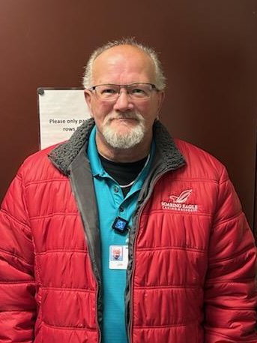
Honoring our Veterans
James
Covey
ARMY & AIR FORCE

Slide 26
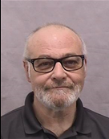
Honoring our Veterans
Thomas Stroebel
NAVY

Slide 27
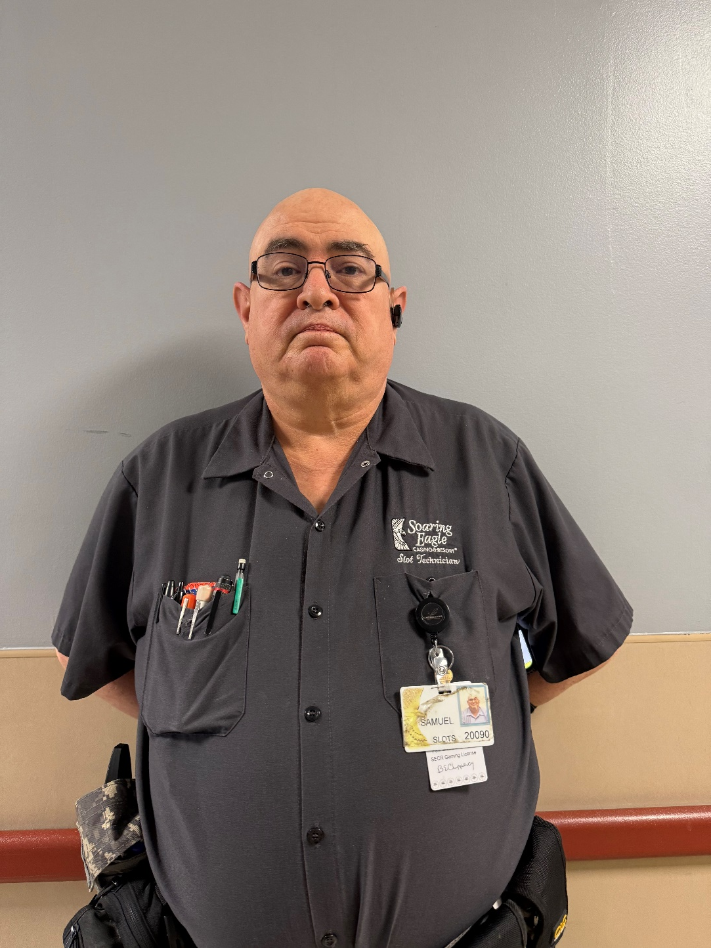
Honoring our Veterans
Samuel Beeg Jr
AIR FORCE

Slide 28
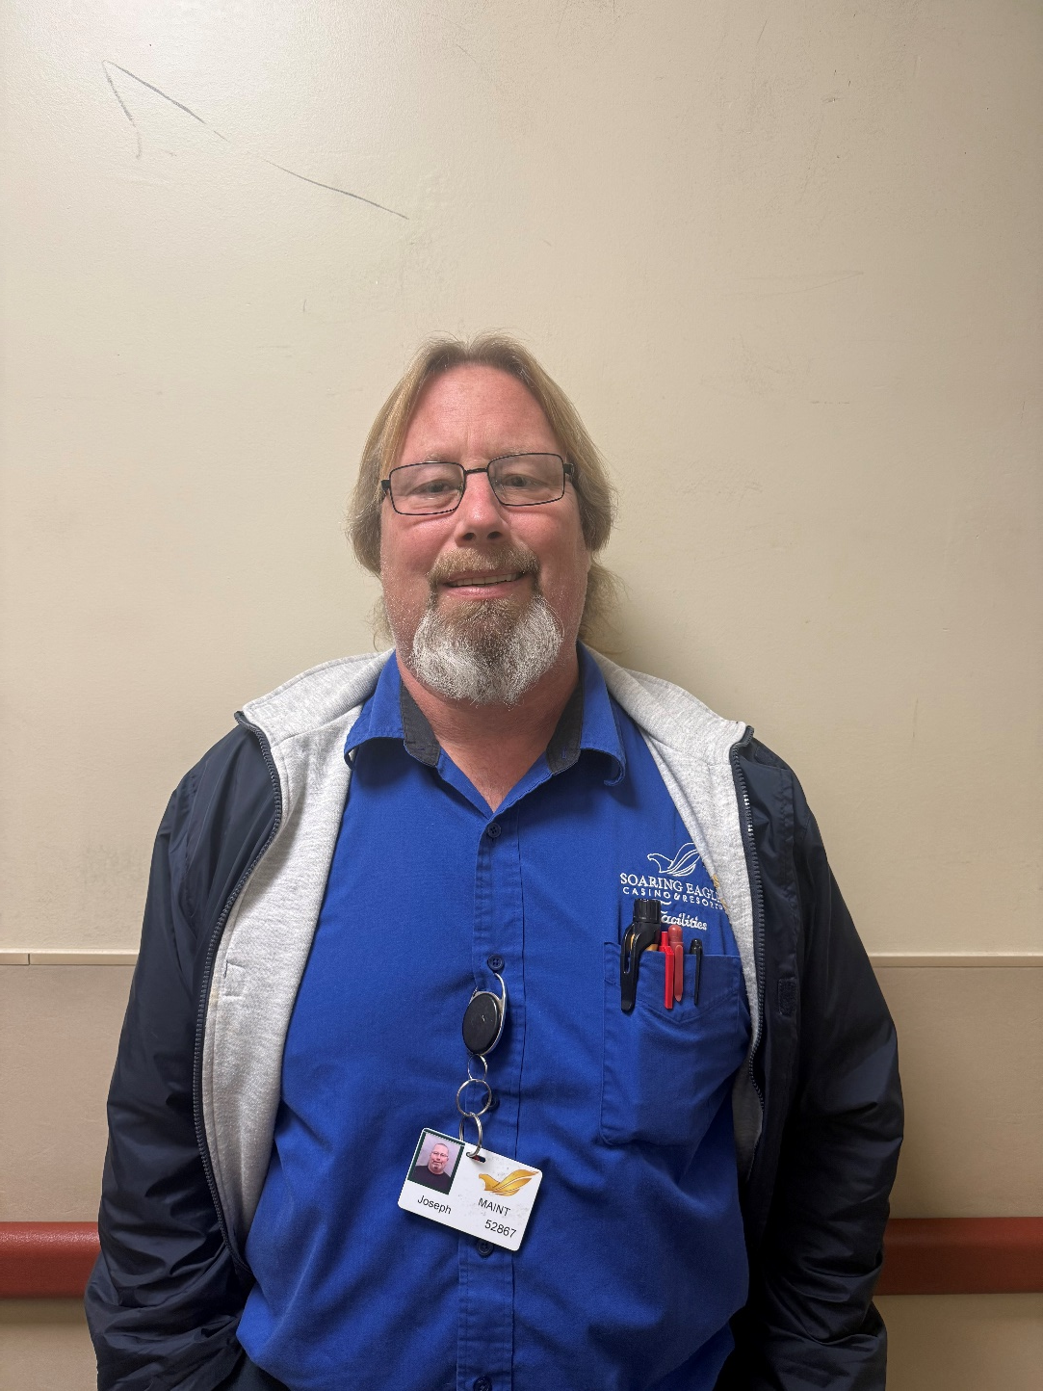
Honoring our Veterans
Joseph Ihnen
NAVY

Slide 29
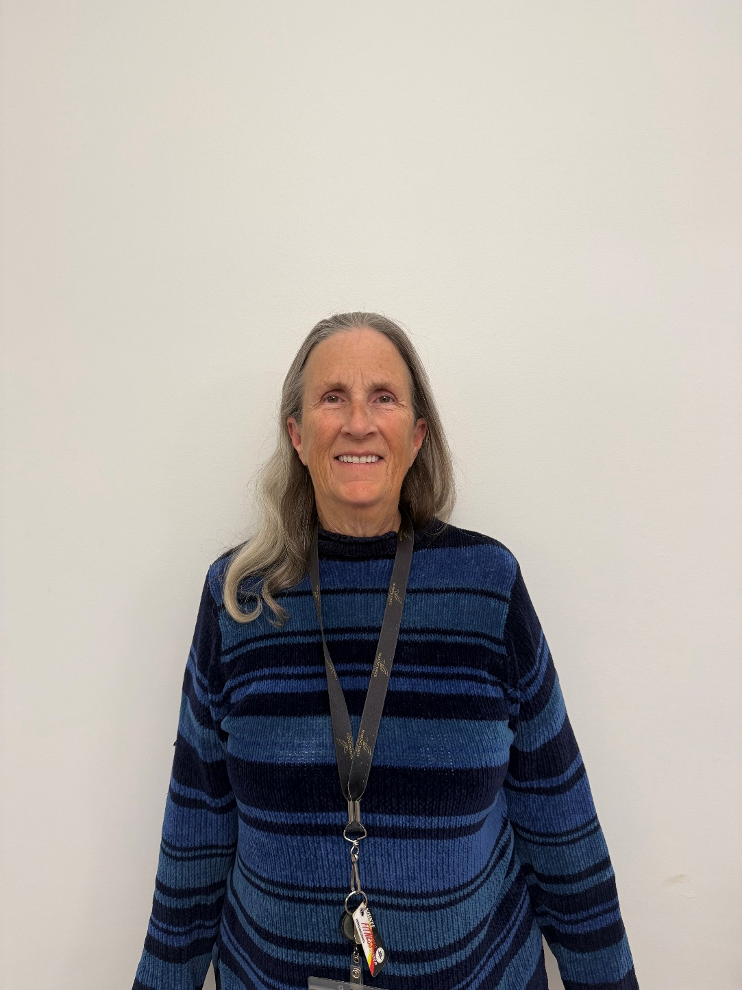
Honoring our Veterans
Robin Keefer
AIR FORCE

Slide 30
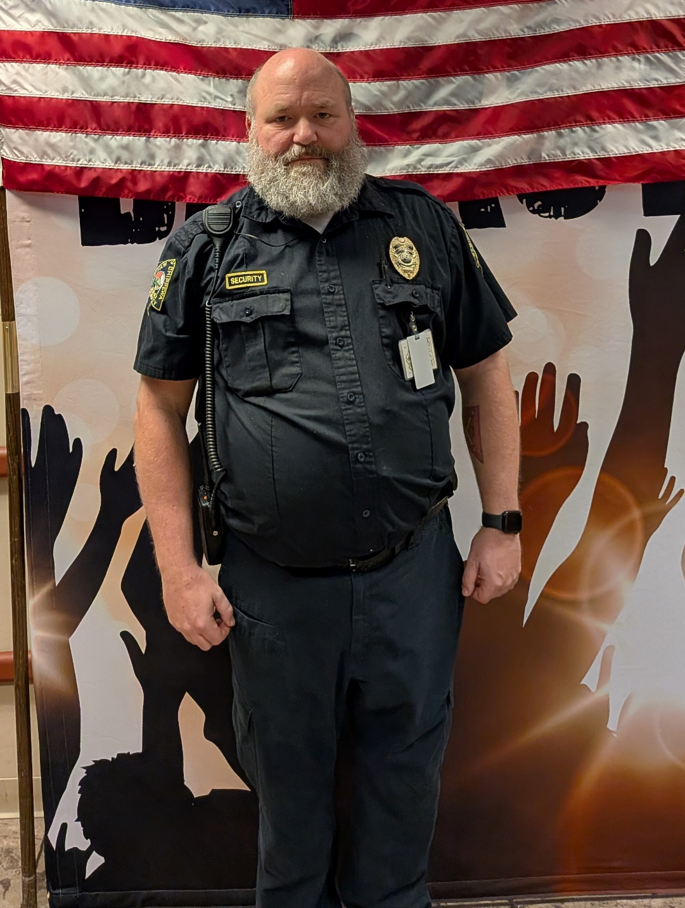
Honoring our Veterans
Marty Zimmerman
ARMY NATIONAL GUARD

Slide 31
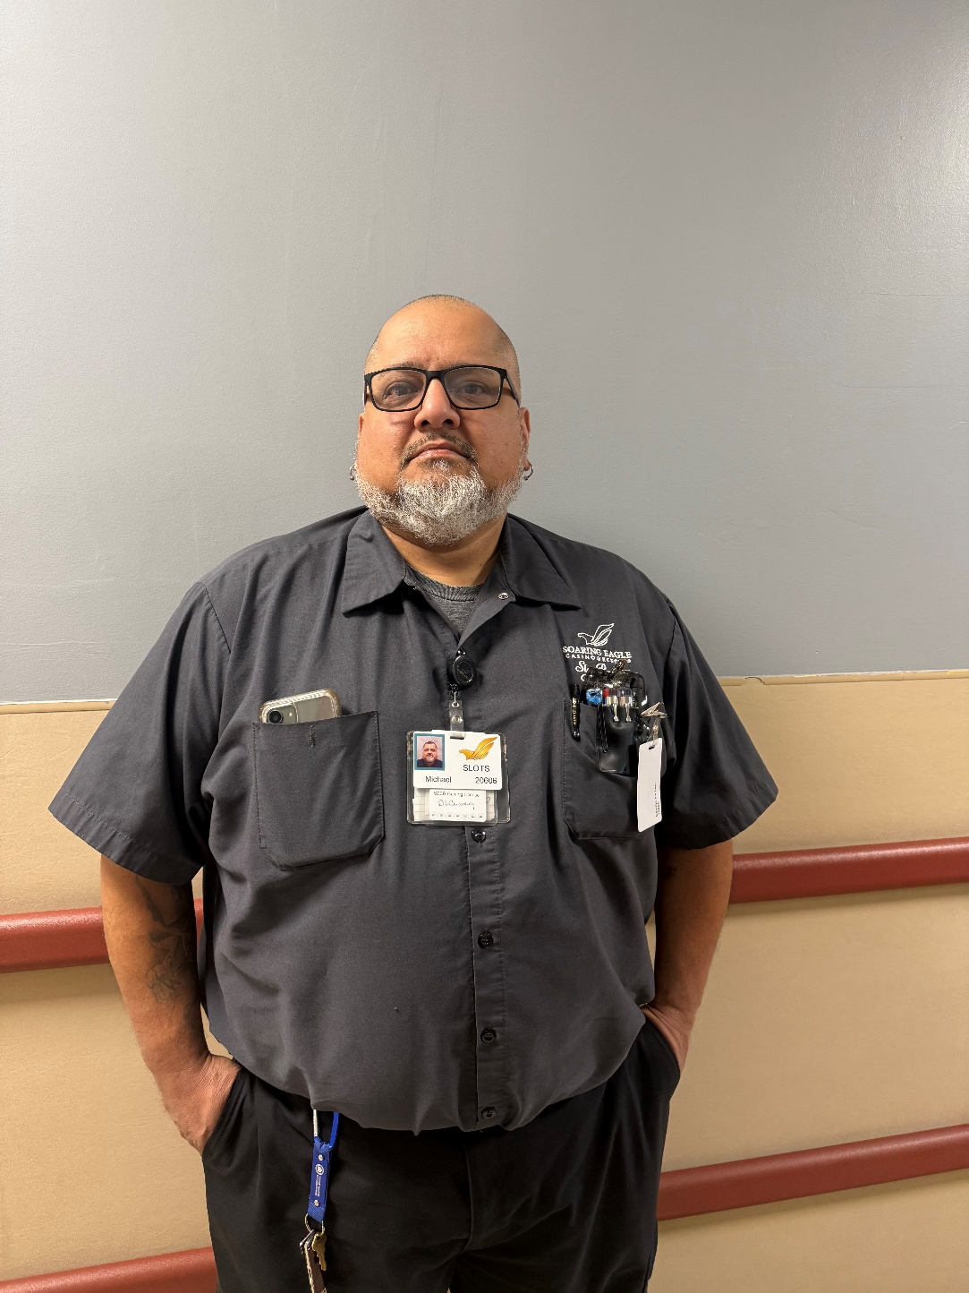
Honoring our Veterans
Michael Castillo
NAVY

Slide 32
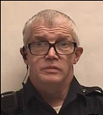
Honoring our Veterans
Michael Quinlan
ARMY

Slide 33
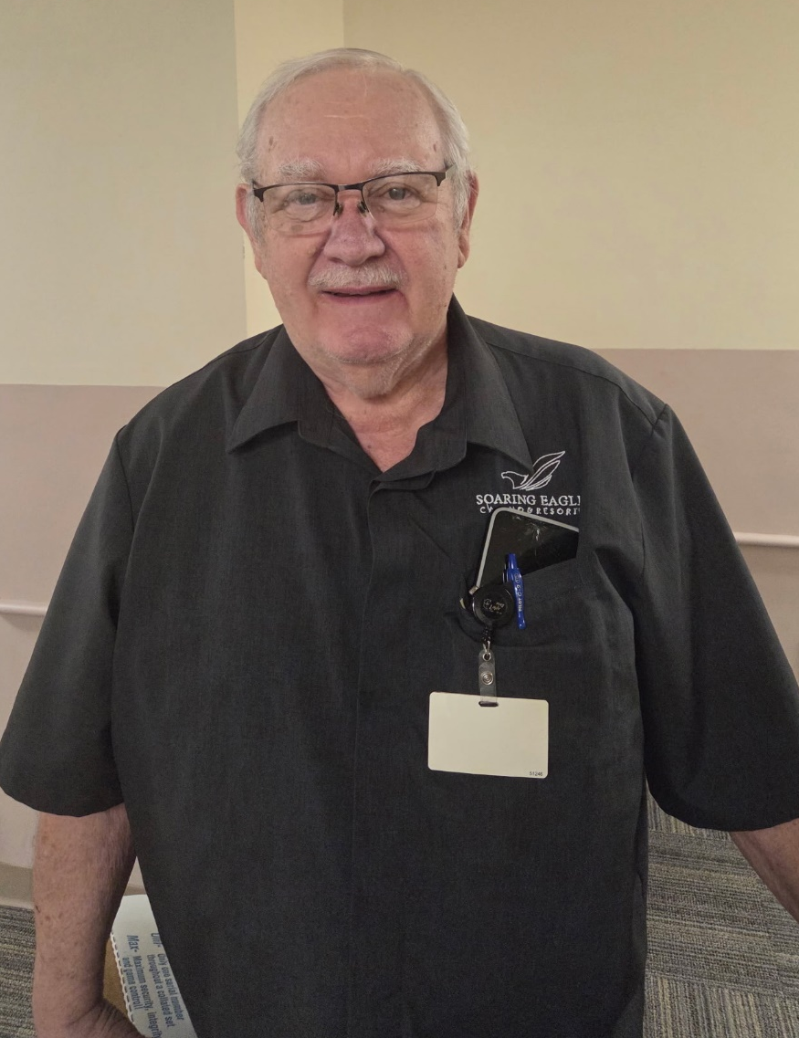
Honoring our Veterans
Michael Stambersky
ARMY NATIONAL GUARD

Slide 34
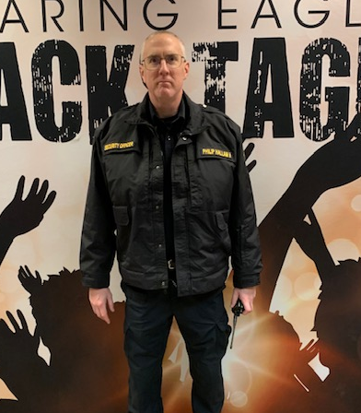
Honoring our Veterans
Philip Hallam Ⅱ
NAVY

Slide 35
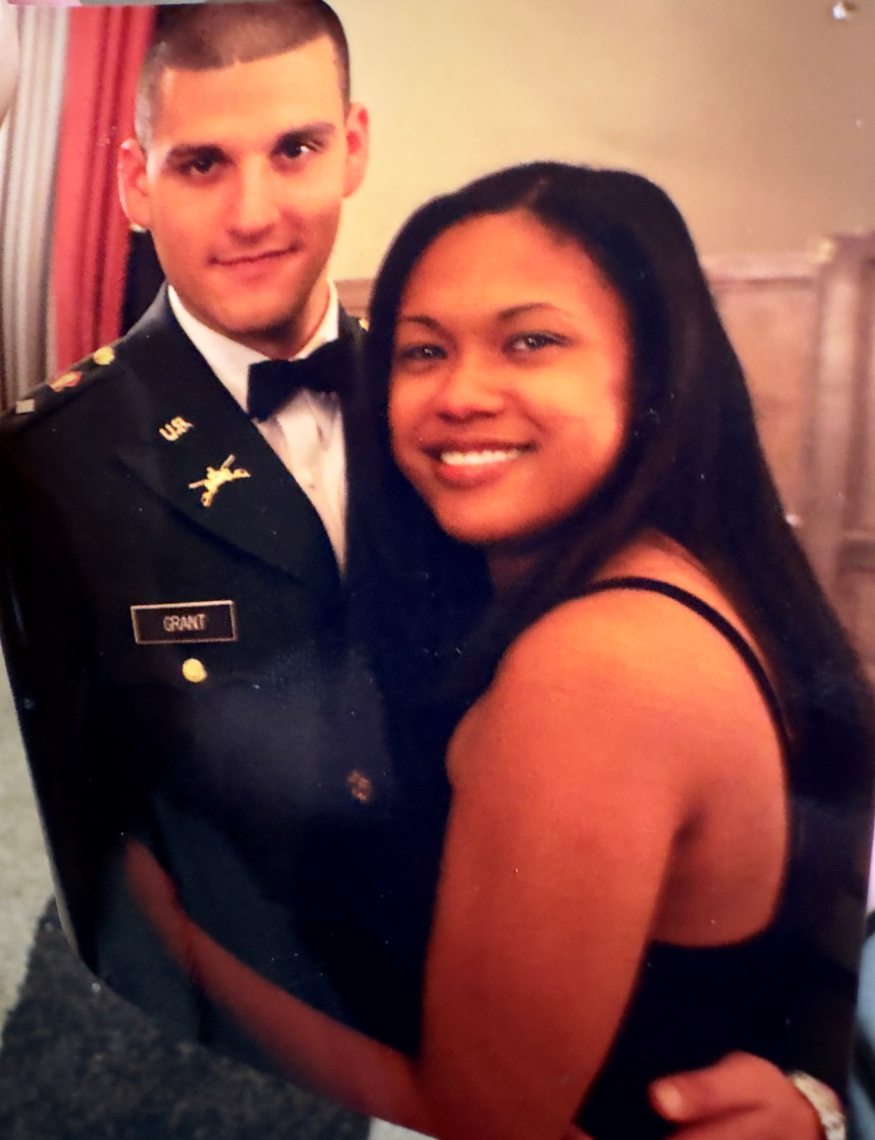
Honoring our Veterans
Kary Grant
ARMY

Slide 36
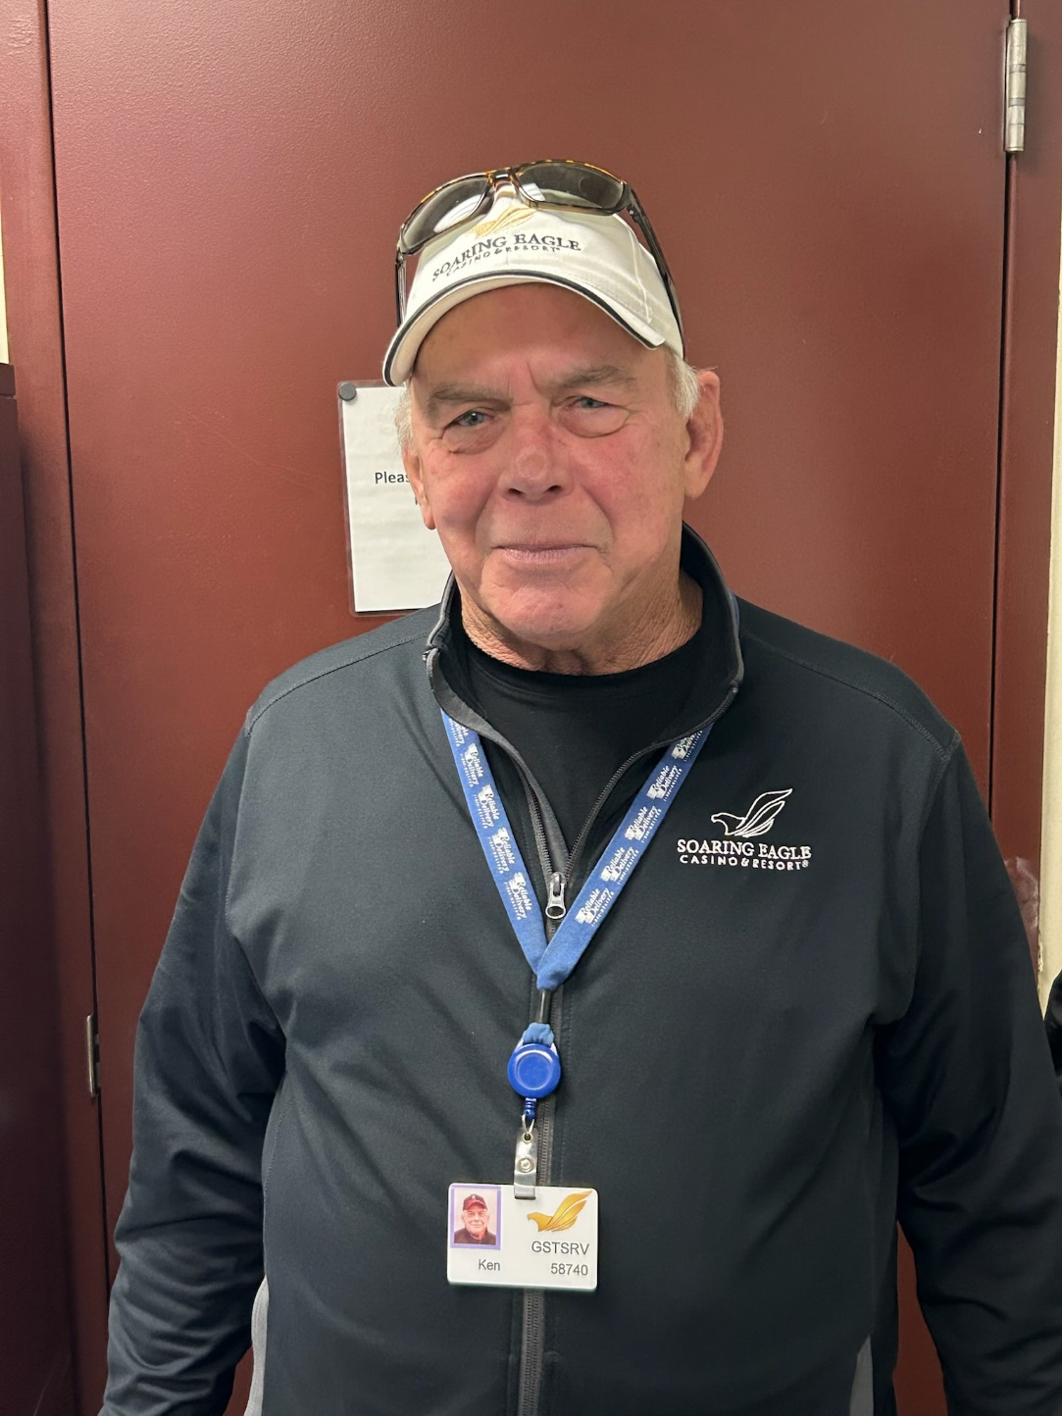
Honoring our Veterans
Ken Brooks
ARMY

Slide 37
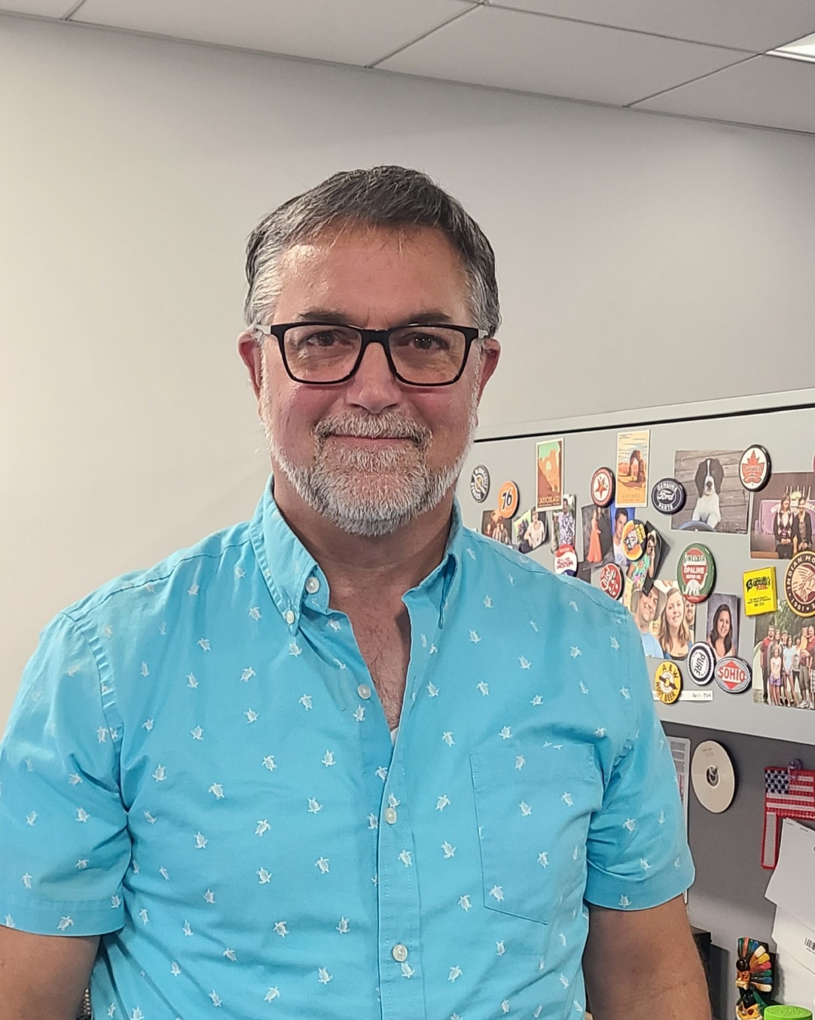
Honoring our Veterans
Marc Buccilli
AIR FORCE

Slide 38
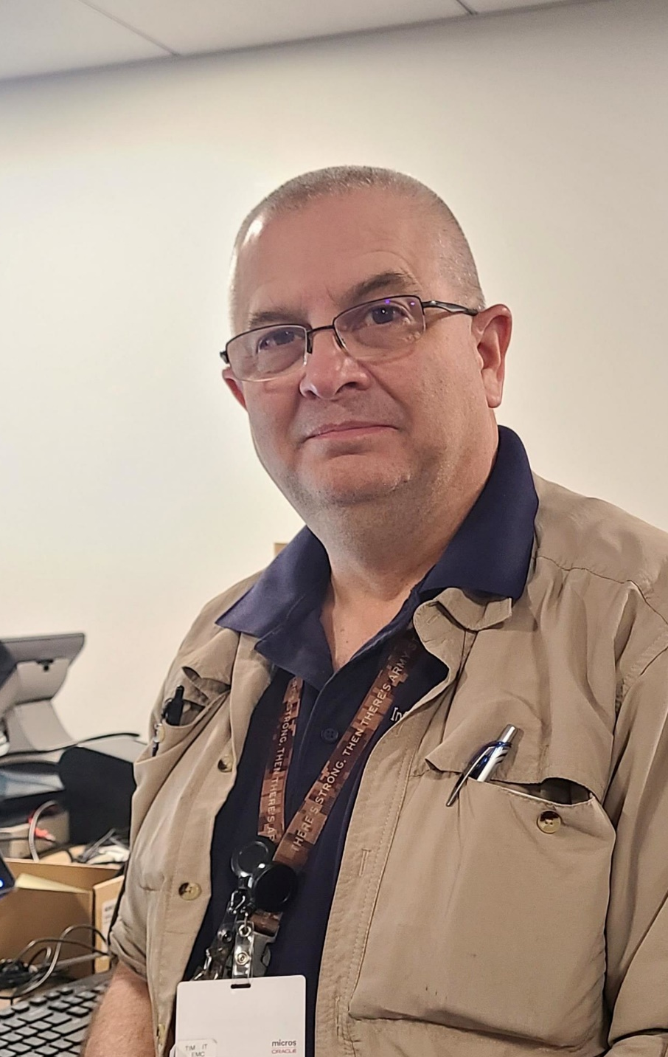
Honoring our Veterans
Tim Wolters
ARMY

Slide 39
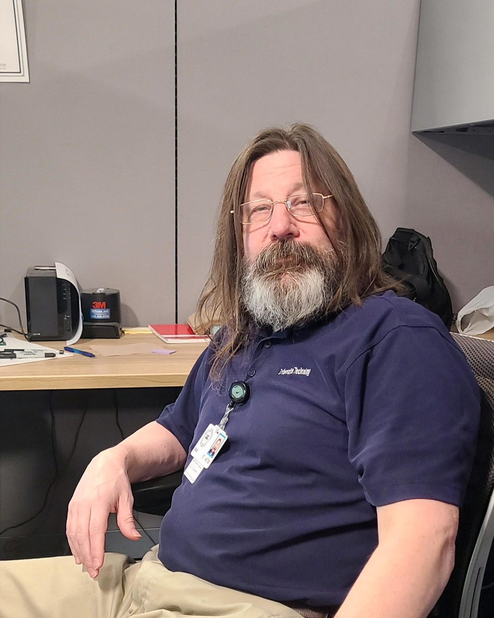
Honoring our Veterans
Matt Kelcher
AIR FORCE

Slide 40
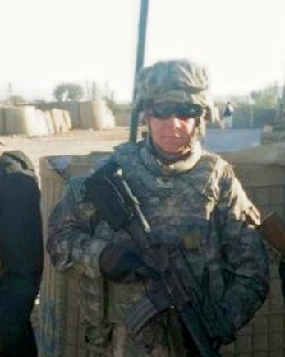
Honoring our Veterans
Fred Hignite
ARMY

Slide 41
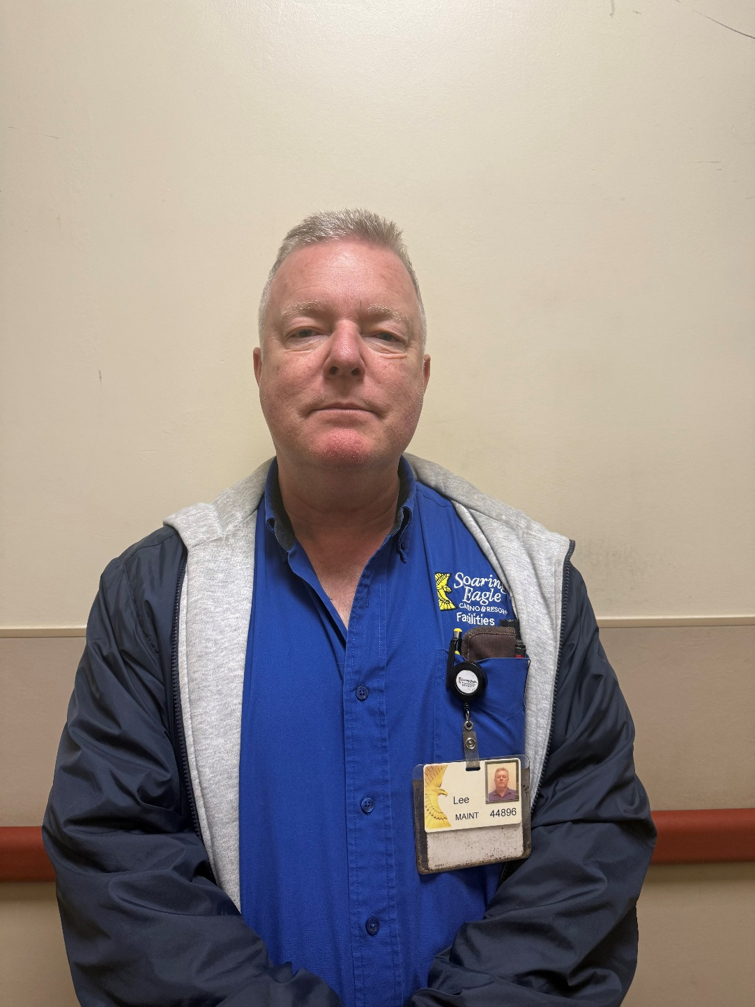
Honoring our Veterans
Lee Dykes
NAVY

Slide 42
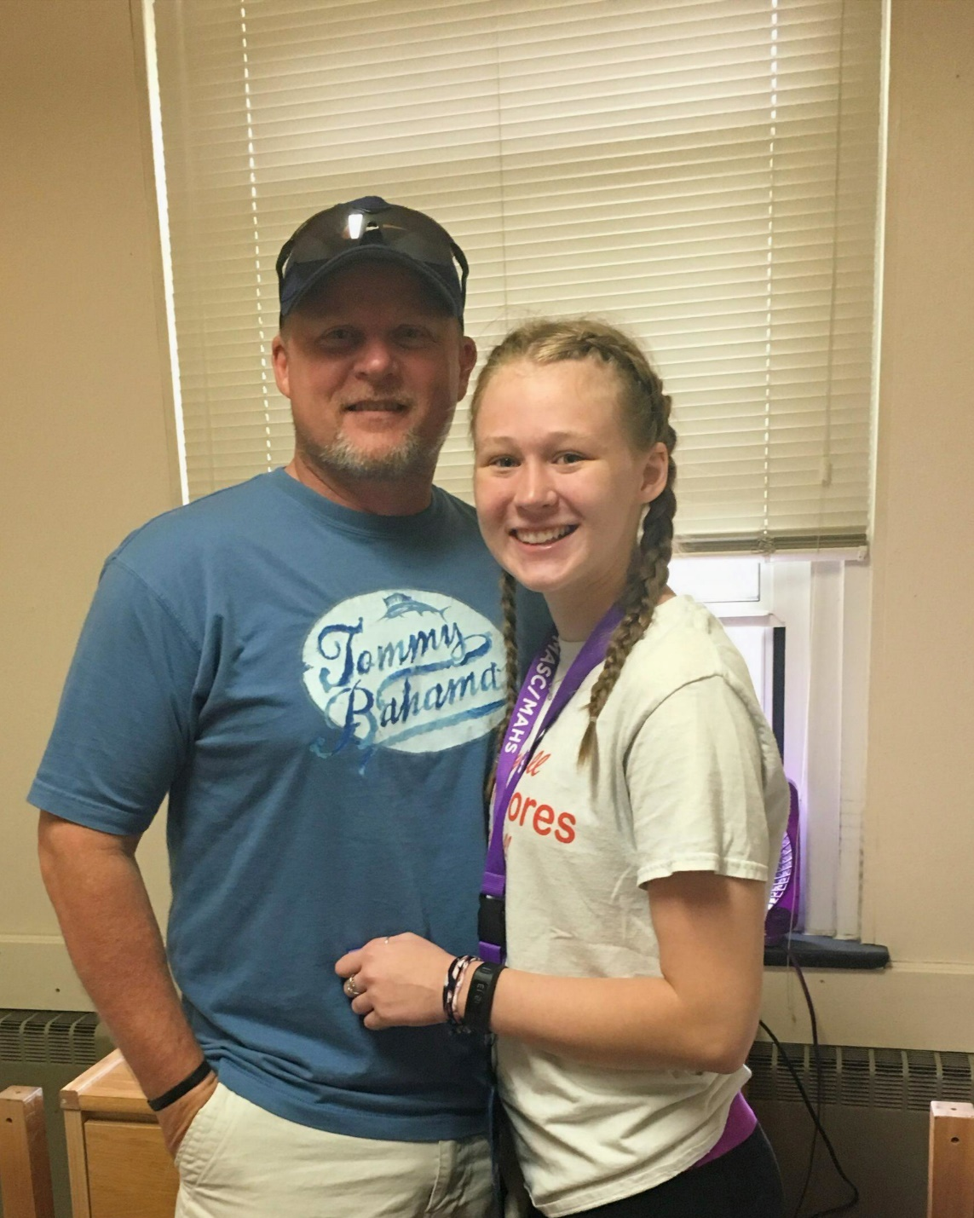
Honoring our Veterans
Rick Hamilton
AIR FORCE

Slide 43
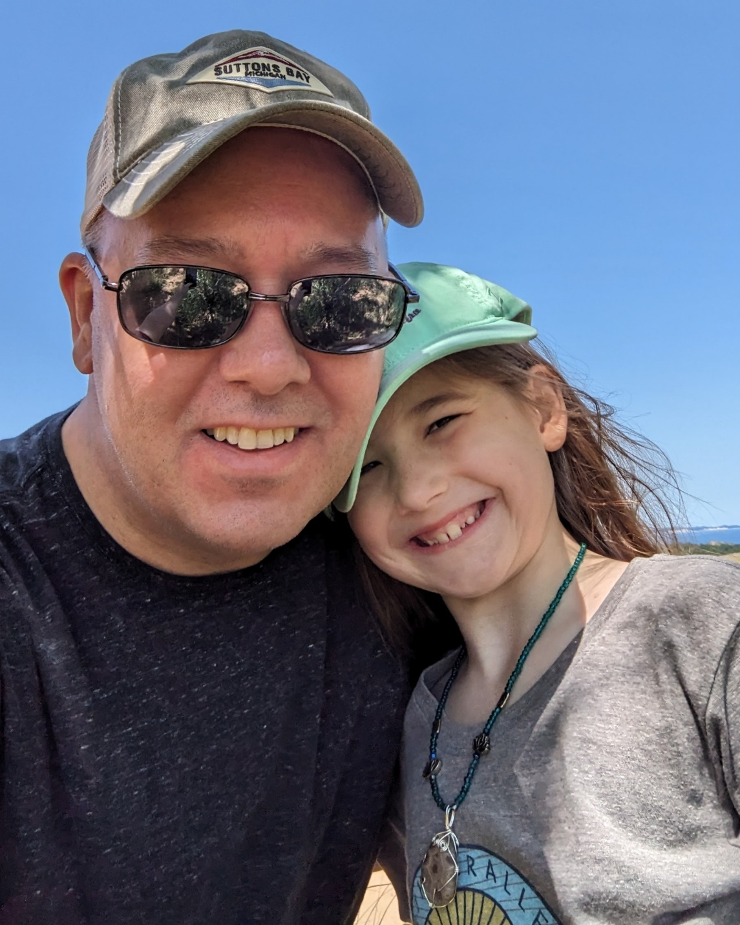
Honoring our Veterans
Steve Fare
ARMY

Slide 44
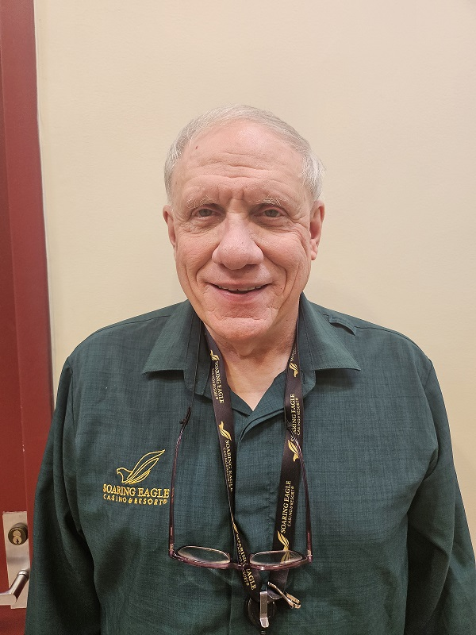
Honoring our Veterans
Lee Fisher
NAVY

Slide 45
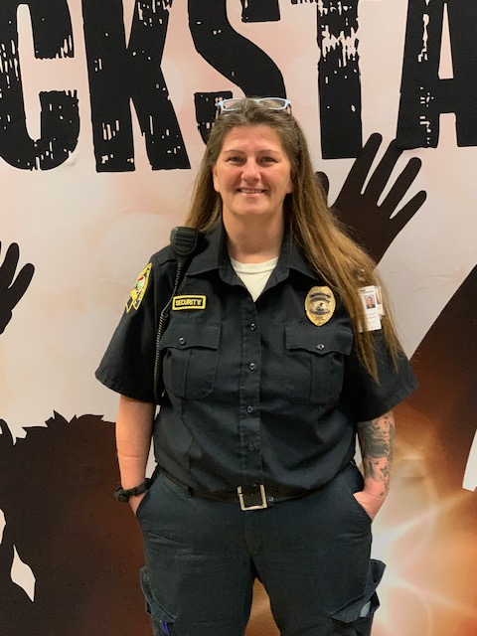
Honoring our Veterans
Lisa Washington
ARMY

Slide 46
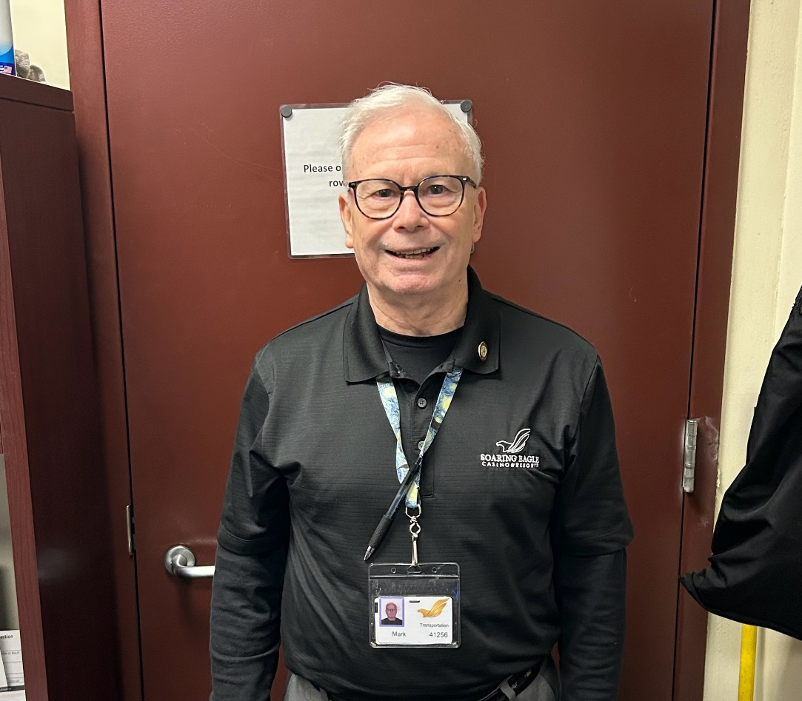
Honoring our Veterans
Mark Chorbagian
MARINES

Slide 47
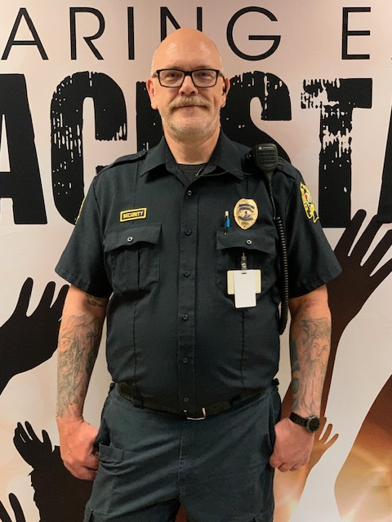
Honoring our Veterans
Dennis Haas
ARMY NATIONAL GUARD

Slide 48
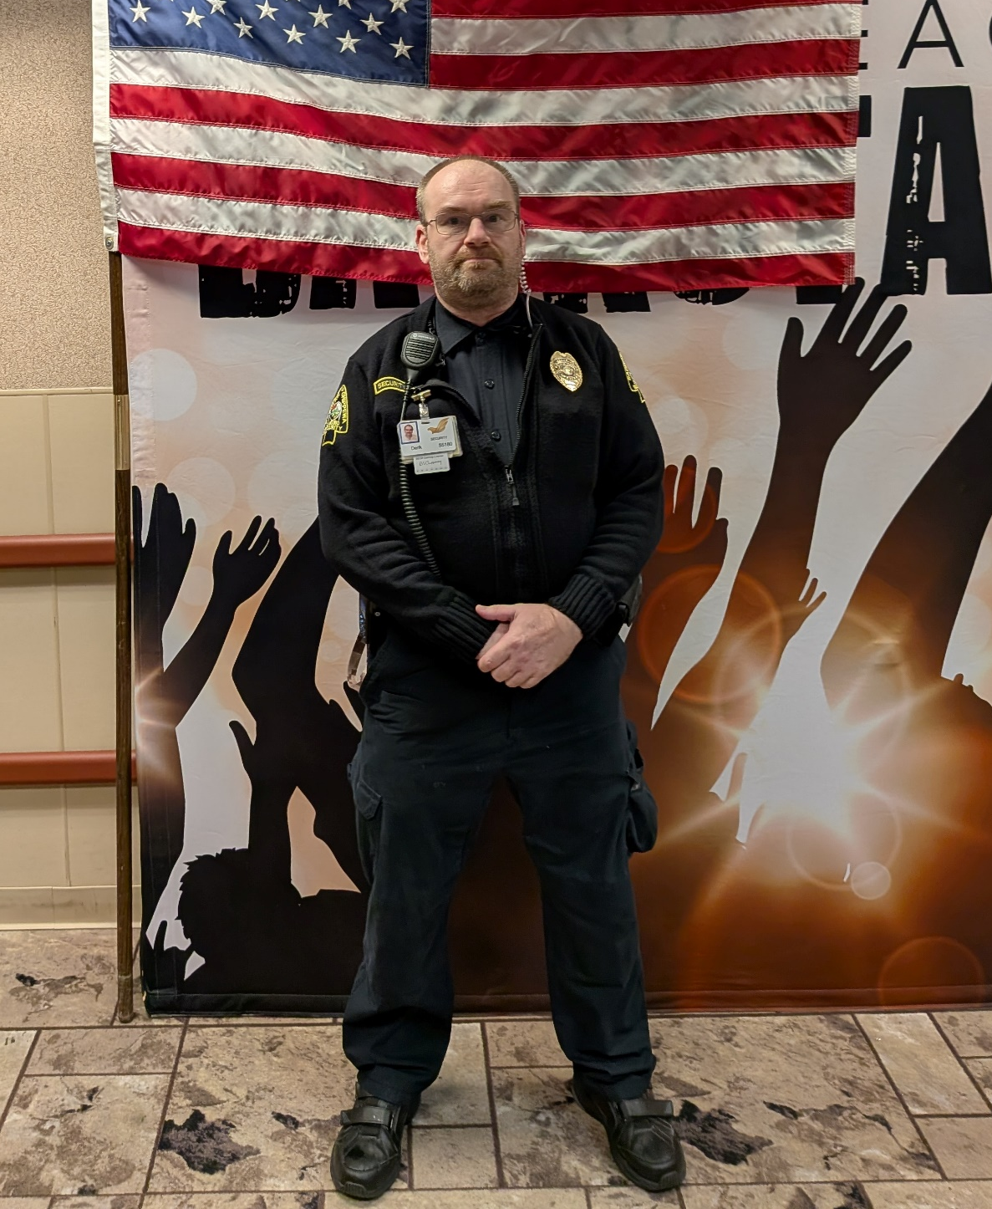
Honoring our Veterans
Derik Hoeltzel
ARMY

Slide 49
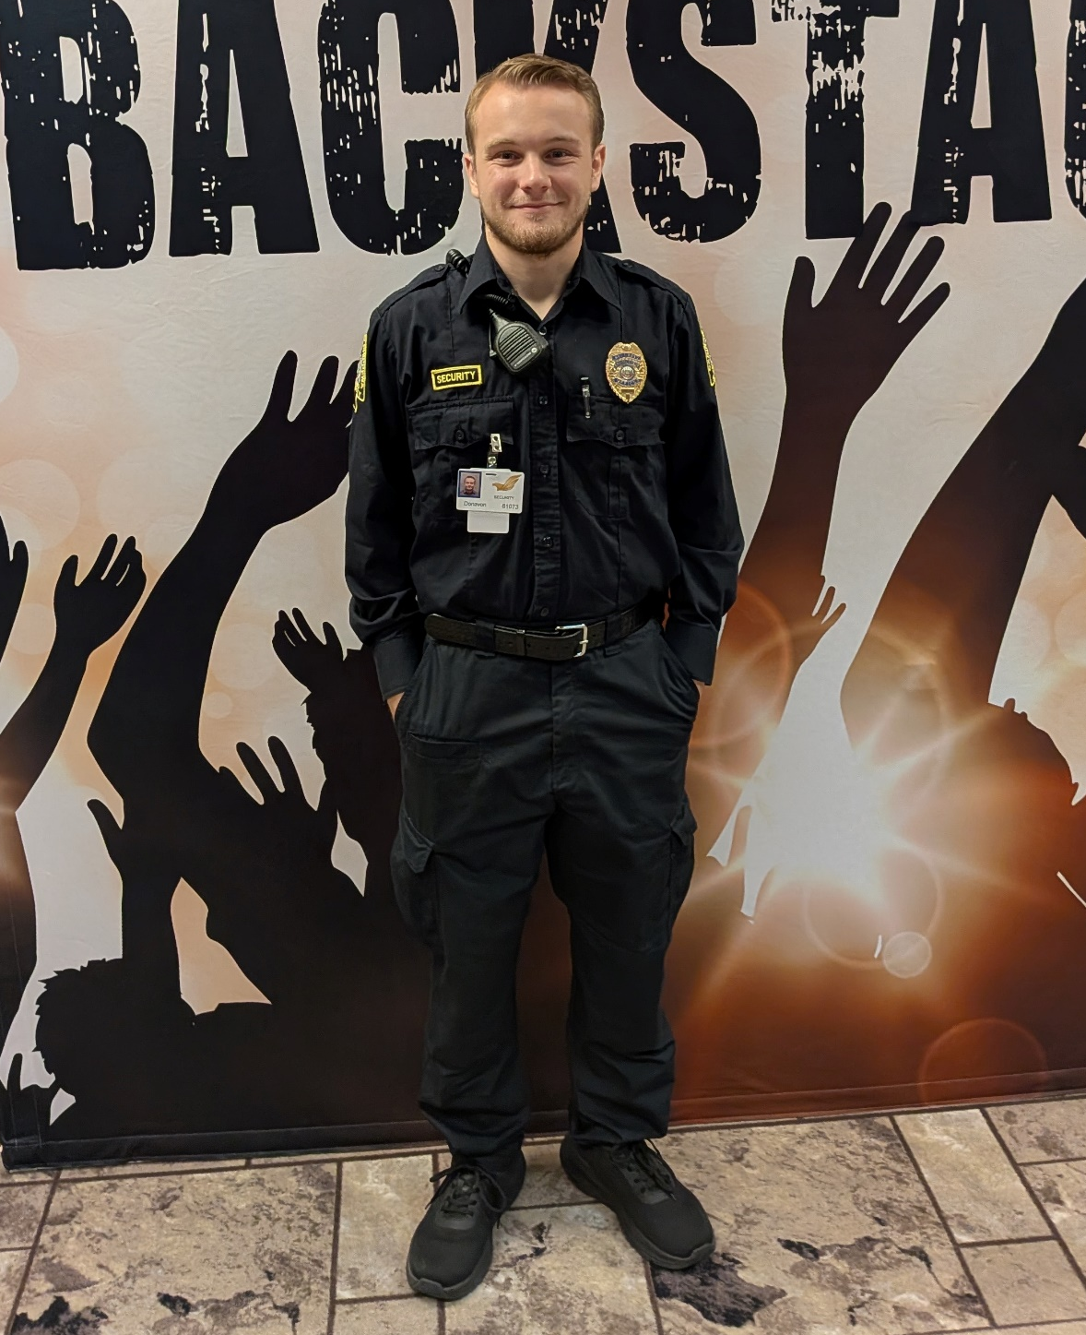
Honoring our Veterans
Donavon Cutis
ARMY NATIONAL GUARD

Slide 50
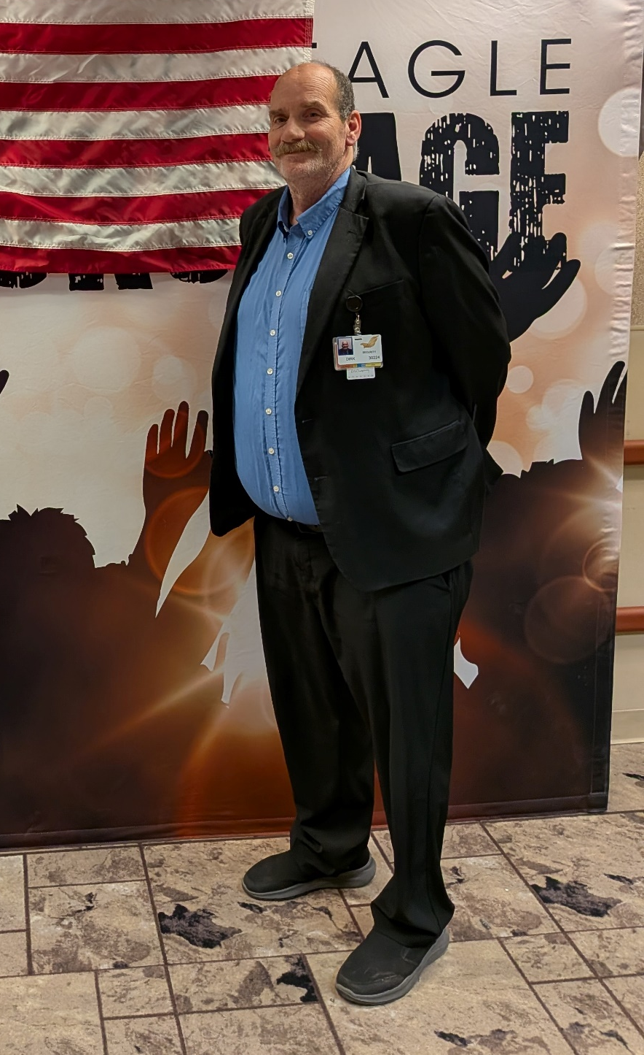
Honoring our Veterans
Dirk Smith
ARMY NATIONAL GUARD

Slide 51
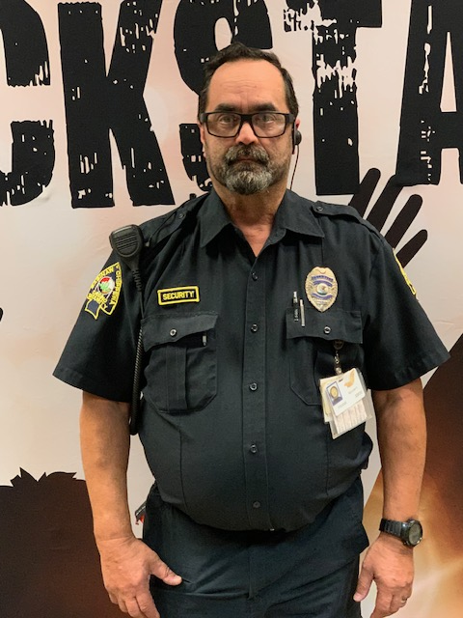
Honoring our Veterans
Frank Andrews
ARMY

Slide 52

Honoring our Veterans
Jarrett Merren
ARMY

Slide 53

Honoring our Veterans
John Rexford
ARMY

Slide 54

Honoring our Veterans
Joseph Fairchild
MARINES

Slide 55

Honoring our Veterans
Joshua Gravelyn
AIR FORCE

Slide 56

Honoring our Veterans
Juan Quintaro
ARMY

Slide 57

Honoring our Veterans
Andrew Yates
MARINES

Slide 58

Honoring our Veterans
Clinton Lenahan
MARINES

Slide 59

Honoring our Veterans
Clinton Voneitzen
NAVY

Slide 60

Honoring our Veterans
Kelly Willis-Benally
ARMY

Slide 61

Honoring our Veterans
Robert Heyart
AIR FORCE

Slide 62

Honoring our Veterans
Daniel Woods
ARMY

Slide 63
Honoring our Veterans
Phil Bird
AIR FORCE
Jeffrey Lopez
NAVY
Dean LaTour
NAVY

Slide 64
Honoring our Veterans
Ross Blackmer
NAVY
Walter Bunker
AIR FORCE
Roger Martin
NAVY

Slide 65
Honoring our Veterans
Greg Dean
ARMY
Joshua Gloria
ARMY
Kevin MacConnell
NAVY

Slide 66
Honoring our Veterans
Douglas Middleton
ARMY
Carl Osborn
AIRFORCE
Robert Armstead
ARMY

Slide 67
Honoring our Veterans
Chris Pego
NAVY
Roy Carranza
ARMY
Gary Clark
ARMY

Slide 68
Honoring our Veterans
Donald Koppela
NAVY
David McConnell
MARINES
Danny Ryckman
ARMY

Slide 69
Honoring our Veterans
David Spicer
NAVY
Nichole Steele
AIR FORCE
Eric Stites
NAVY

Slide 70
Honoring our Veterans
Glen Coffin
MARINES
Ernest Fletcher
ARMY NATIONAL GUARD
Dan Jarman
ARMY

Slide 71
Honoring our Veterans
Brian Gonzalez
MARINES
Ford Carr
AIR FORCE
Michael Walker
AIR FORCE

Slide 72
Honoring our Veterans
Cory Polom
MARINE CORPS
Barry Histead
ARMY
David Bennett
ARMY

Slide 73
Honoring our Veterans
Robert Snyder
AIR FORCE
Samuel Johnson
ARMY
Brian Baird
AIR FORCE

Slide 74
Honoring our Veterans
Todd Nordman
Kimberly Sisk
Stuart Bookey
India Perez
Jordan Logan

